Slide 1

Promoting Academic Integrity in College
FALL 2024
Sub Topic:
AVOIDING ACADEMIC MISCONDUCT IN COLLEGE
DATE: FRIDAY, 4 OCTOBER 2024
VENUE: SCHOOL OF LAW AUDITORIUM
A WRITING CENTER PRESENTATION FOR AUN 101

Slide 2
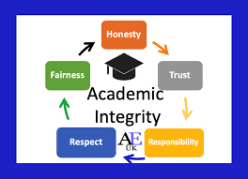
Introduction
  The definition of academic misconduct encompasses various forms of cheating, such as plagiarism, collusion, fabrication, and ghostwriting (contract cheating).
  Understanding the importance of upholding academic integrity and ethical behavior is not only a personal responsibility but is also crucial to maintaining a fair and honest learning environment.
  Additionally, it is critical to be aware of the potential consequences of academic misconduct, including academic penalties, loss of credibility, and damage to one's reputation.

Slide 3

Plagiarism - The Silent Thief
  Plagiarism is using someone else's work or ideas without proper credit, including direct copying, paraphrasing without citation, and using someone else's ideas without acknowledgment.
  Proper citation and referencing are crucial to crediting the original authors, adding credibility to the work, and avoiding plagiarism.
  Plagiarism detection software plays a significant role in identifying potential instances of plagiarism. It can flag potential issues by comparing the submitted work against a vast database of published material. However, it's important to note that these tools have limitations and may not detect all forms of plagiarism.

Slide 4
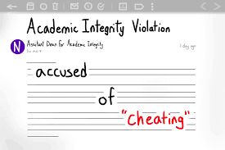
Cheating - A Shortcut to Nowhere
  Cheating involves acting dishonestly to gain an unfair advantage, such as unauthorized assistance or using prohibited materials.
  It undermines integrity, moral character, and personal growth.
  Honest effort and fair competition are essential for developing integrity and contributing to a just society.

Slide 5

Collusion - Two Wrongs Don't Make a Right
  Collusion is an unauthorized collaboration or submitting another's work.
  Individual effort and independent learning are important for personal growth.
  Collusion has severe consequences for all parties involved, undermining personal development and eroding trust and credibility.

Slide 6
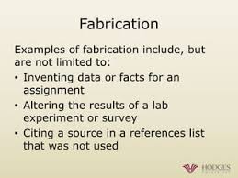
Fabrication - Building on Falsehoods
  Fabrication involves falsifying data or inventing sources, impacting the integrity of research and academic work.
  Honesty and accuracy are crucial in all academic endeavors.

Slide 7

Generative AI - Dos and Don'ts
Don’ts ❌
Don’t Submit AI-Generated Work as Your Own
  Submitting assignments or essays written entirely by AI without your input is plagiarism and violates academic integrity policies.
Don’t Rely Solely on AI for Research
  Avoid using AI as a shortcut for in-depth research. AI tools can miss context and nuance or cite nonexistent studies, which may mislead your analysis.
Don’t Skip Critical Thinking
  Don’t allow AI to think for you. Engage critically with the material and ensure you fully understand it. AI can help, but it can't replace your learning process.
Don’t Use AI for Exam Cheating
  Using AI tools during closed-book exams or unauthorized ways violates academic conduct policies. If detected, it can lead to severe consequences.
Don’t Generate Fake Citations with AI
  Some AI tools can create non-existent or inaccurate citations. Always ensure any references are verifiable and from credible sources.

Slide 8

Generative AI - Dos and Don'ts
Do’s ✅
Use AI for Inspiration and Idea Generation
  AI can help brainstorm topics, outline ideas, or assist with research direction. Use it as a starting point, but develop the content yourself.
Verify Information from AI
  Cross-check any data or references AI generates. Generative AI can produce incorrect or outdated information.
Cite AI Where Appropriate
  If your institution permits include a citation when using AI-generated content, just as you would for any other source. Always clarify when AI has contributed to your work.
Use AI to Improve Writing
  Use AI for grammar and style checks, to rephrase sentences, or to make your writing clearer. AI can help polish your work but should only write some sections for you.
Ask for Clarifications from Professors
  If you need more clarification about the ethical use of AI in a specific assignment, ask your instructor for guidance to ensure you're following the rules.

Slide 9

Understand Academic Integrity Policies at AUN
  Familiarize yourself with your institutional and departmental academic integrity policies to ensure that you understand the specific definitions and examples of academic misconduct.
  Read your copy of the AUN Student Academic Integrity Code.
  Know the reporting procedures and potential consequences associated with academic dishonesty.

Slide 10



Seeking Clarification and Support
  Ask your professors or academic advisors to clarify assignments or concerns about academic integrity.
  Utilize AUN’s academic resources, such as the writing center, advising, and the Honor Society tutoring services.
  Seek support from your instructors, trusted friends, family, or mentors.

Slide 11

Time Management and Organization
Effective time management and organizational skills are essential for avoiding procrastination and last-minute pressures.
Breaking down large assignments into smaller, manageable tasks and creating a study schedule can help students stay on track and be more productive.

Slide 12
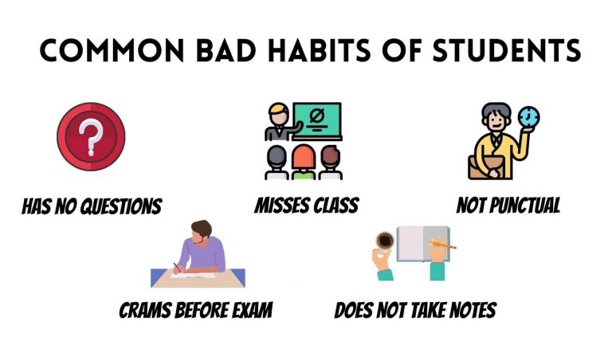

Effective Study Habits
  Develop effective study habits, such as active reading, note-taking, and summarizing.
  Find a study environment that works best for you.
  Attend Writing Center essential skills workshops and learn to use different learning strategies and techniques.

Slide 13
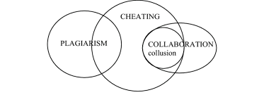
Collaboration vs. Collusion
  Understand the difference between acceptable collaboration and unauthorized collusion.
  Follow your professor's guidelines on group work and collaboration.
  Ensure individual contributions are identified and acknowledged.

Slide 14
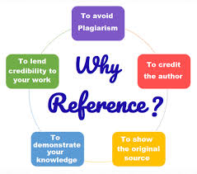
The Importance of Referencing
  - Learn to cite and reference sources using different citation styles such as MLA, APA, IEEE, and Chicago.
  - Understand the purpose and importance of referencing in academic work.
  - Use referencing tools and resources available to you. The Library staff can help with this, too.

Slide 15

Consequences of Academic Misconduct
  Academic misconduct has potential consequences, ranging from poor grades and course failure to suspension and expulsion.
  Sanctions can have a long-term impact on your academic and professional reputation.
  Academic dishonesty will be reflected in your transcript.
  It is essential to take responsibility for your actions.

Slide 16

Maintaining Academic Integrity
This presentation reinforces the significance of academic integrity and ethical behavior.
It is also designed to motivate you, dear AUN 101 students, to take pride in your work and accomplishments and promote a culture of honesty and respect at AUN.

Slide 17

Conclusion
Academic integrity is an extension of integrity and should be a way of life.
Make informed and ethical choices throughout your academic journey.
The Writing Center wishes you success in your studies and future endeavors.

Slide 18
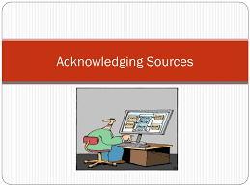
Acknowledgments
Image on Slide 1
Image on Slide 2
Image for Slide 4
Image for Slide 5
Image for Slide 6
Image for Slide 7
Image for slide 8
Image for Slide 9
Image for Slide 10
Image for Slide 11
Image for Slide 12
Image for Slide 12a
Image for Slide 13
Image for Slide 14
Image on Slide 16
Image for Slide 17
Image for Slide 18
Image for Slide 19

Slide 19

Thank you for Your Time!
Questions can be sent directly to writingcenter@aun.edu.ng
You can also walk into the Writing Center on the first floor of the Library and speak with any of our instructors.

