Slide 1

The Importance of Writing for Social Science College Students:
Politics and International Studies
Honors Seminar
31 OCTOBER, 2023

Slide 2
Agenda
We’re here to explore why writing skills are crucial for students in the field of Politics and International Studies.

Slide 3
Purpose
This presentation is to help you understand the role of writing in academic success and future careers.

Slide 4

What Are Social Sciences?
Social sciences encompass disciplines that study human behavior, societies, cultures and interactions.
For example, Sociology examines social structures, while psychology explores individual behavior and cognition.
Again, Anthropology focuses on cultures, and political science delves into political systems.

Slide 5
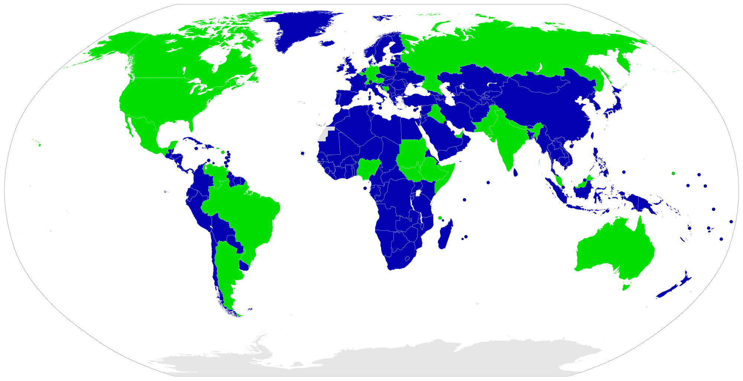
Politics and International Studies
Politics and international studies are typically considered part of the social sciences.
These fields fall within the broader domain of the social sciences, which encompass various disciplines that study human behavior, societies, and interactions.

Slide 6
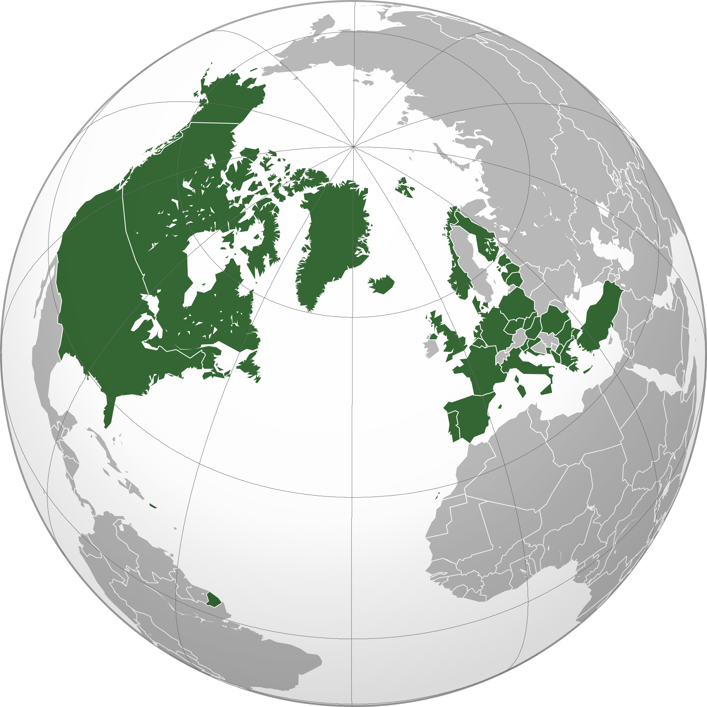
PIS
"Politics" typically refers to the study of government, political systems, political behavior, and the distribution of power within societies. It is a core subfield within the social sciences, and political scientists use a variety of methods to analyze and understand political phenomena.
"International studies" or "international relations" focuses on the interactions between countries, diplomacy, international organizations, global issues, and the dynamics of the international system. This field is also firmly situated within the social sciences.

Slide 7

The Role of PIS
Both politics and international studies contribute to our understanding of how societies and nations function, interact, and address complex challenges, making them integral components of the social sciences.

Slide 8
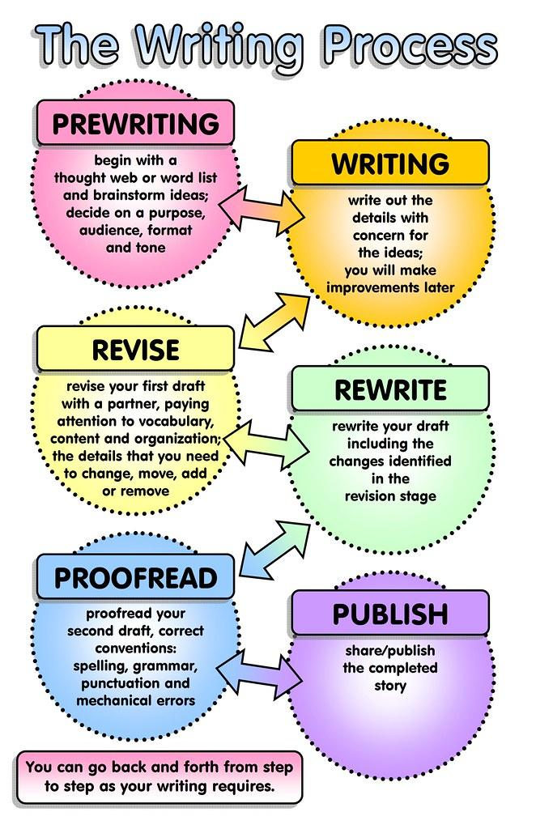
Communication of Knowledge
Writing is the main form of conveying information in the social sciences, particularly academic writing.
An example of academic writing is academic journals, where scholars publish their research to the academic community and read other articles.
In PIS, you'll encounter various forms of writing, such as essays, policy briefs, research papers, and even social media posts for political campaigns. Each requires a different writing style and skill set
Effective writing in Social Sciences is like a universal language that allows you to communicate your ideas, analyze complex issues, and persuade others. Writing is a powerful tool that helps you articulate your thoughts and communicate clearly.

Slide 9
Academic Writing & Academic Success
Unlike creative writing, academic writing is characterized by:
Formal language
Clear structure
Citations from authoritative sources.
The four academic writing styles are:
Descriptive: Describing subjects with clear language that appeals to the five senses.
Analytical: Uncover the deeper meaning of an idea through evaluation and critical analysis.
Critical: Analyzing or evaluating a specific text from your point of view.
Persuasive: Writing that convinces the reader to believe or do something.
Good writing boosts your academic performance. When you can write a compelling essay or research paper, you're more likely to earn higher grades. For example, if you're writing a political science paper, a well-structured argument will get your ideas across effectively.

Slide 10

Clarity and Precision
Organized structure: Writing helps social scientists organize their ideas so that it is easy to understand.
Promoting clarity: Writing allows social scientists to share complex ideas with precision and coherence.

Slide 11

Critical Thinking
Writing fosters critical thinking: It encourages students and researchers to formulate well structured arguments and defend their claims.
Analytical skills: Social scientist need to evaluate evidence, consider alternative perspectives, and construct reasoned arguments.

Slide 12
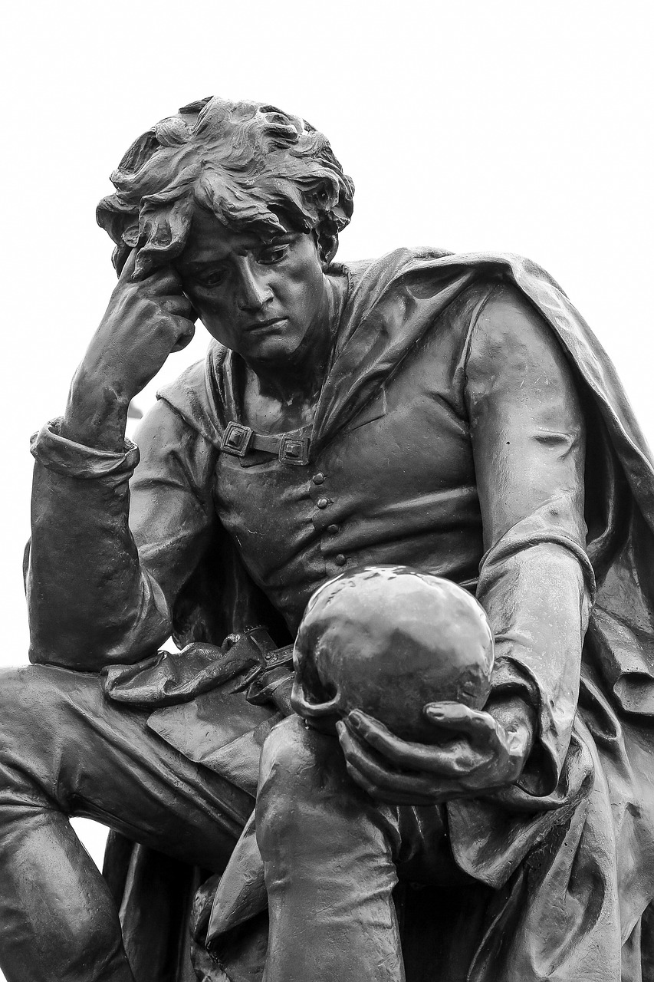
Building a Knowledge Base
Writing in social sciences contributes to a growing body of knowledge that future researchers can build upon.
Proper citation ensures the traceability of information, which is crucial for scholarly progress.
Avoid plagiarism and provide proper attribution

Slide 13

Interdisciplinary Connections
Bridging disciplines: Writing enables social scientists to collaborate and draw connections between different fields.
Holistic understanding: Interdisciplinary research and writing provide a more comprehensive understanding of complex societal issues.

Slide 14

Challenges in Writing
Common challenges social science researchers face in writing include writer's block, data interpretation, and referencing.
Strategies and resources for overcoming these challenges include writing groups or centers, style guides, and time management techniques.
Enhancing your writing abilities involves practice, feedback, and resources. Seek out writing centers, peer reviews, and online courses to improve your skills. Think of it as honing your writing like a craft.

Slide 15

Career Opportunities
Proficient writing opens doors to diverse career options. If you can write policy briefs, reports, or diplomatic cables with precision, you become a valuable asset in the job market.
Remember that strong writing is essential for academic success and future Politics and International Studies career prospects.

Slide 16

Case Studies
Showcase impact: Present case studies or examples where social science writing led to real-world impact, policy changes, or societal improvements.
Success stories: Share specific instances where research and writing made a difference.

Slide 17
Thank you🙂

