Slide 1
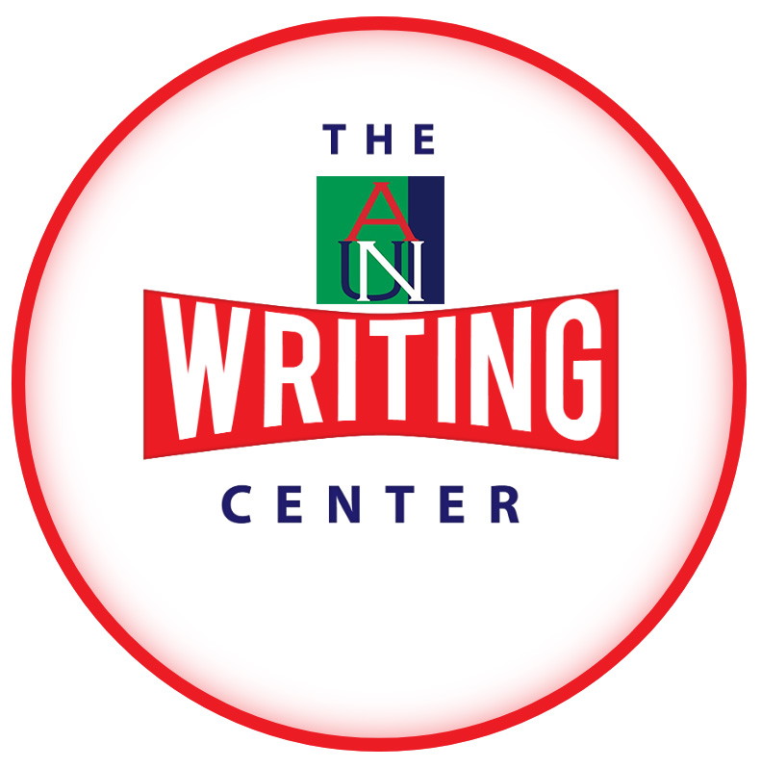
Empowering Students to
Craft Meaningful Essays
WRITING SEMINAR
Subtitle: Unlocking Essay Potential: The Writing Center Advantage
AUN Writing Center
Monday, February 5, 2024

Slide 2
INTRODUCTION TO THE WRITING CENTER
The Writing Center is a free academic resource dedicated to helping students improve their writing skills and achieve academic success.
Whether you're struggling with brainstorming ideas or polishing your final draft, the Writing Center will support you.

Slide 3

SERVICES OFFERED
Our Writing Center offers a range of services to cater to the diverse needs of students, including one-on-one consultations, workshops, and online resources. No matter your writing proficiency level or subject area, we're committed to providing personalized assistance tailored to your goals.

Slide 4

INDIVIDUAL CONSULTATIONS
Our experienced writing tutors and staff work closely with students during one-on-one consultations to address their unique writing challenges and goals and guide them through the writing process.
From brainstorming ideas to refining thesis statements and organizing content, our tutors provide constructive feedback and guidance to help you develop your ideas into cohesive and well-supported essays.

Slide 5

WORKSHOP OPPORTUNITIES
Our workshops cover topics essential for essay writing success, such as thesis statement development, citation styles, and effective revision strategies.
These interactive sessions, led by knowledgeable staff, allow students to enhance their writing skills in a collaborative and supportive environment.

Slide 6

ONLINE RESOURCES
The Writing Center’s page is under Academics on the school’s website.
We periodically upload resources to help students strengthen their writing skills and overcome common challenges.

Slide 7

CONCLUSION
The Writing Center empowers you to become a more confident and skilled writer.
Whether aiming for an A+ or improving your writing abilities, we're committed to providing the guidance and resources you need to succeed in your academic endeavors.

Slide 8

Overview of the Writing Process
The writing process is a series of interconnected stages: prewriting, drafting, revising, editing/proofreading, and submission/publishing.

Slide 9

PREWRITING STAGE
This is the initial stage of the writing process, where writers brainstorm ideas, conduct research, outline their thoughts, and organize their materials before starting to write. This stage is crucial for generating and refining ideas, identifying the purpose and audience of the writing, and establishing a clear direction for the piece. Some common prewriting strategies include freewriting, brainstorming, mind mapping, outlining, conducting research, and gathering relevant sources and materials. Prewriting helps writers clarify their thoughts, organize their content, and lay the groundwork for effective writing.

Slide 10
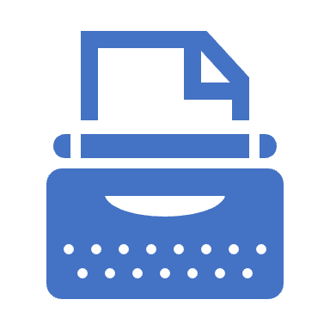
DRAFTING STAGE
Drafting is the stage where writers begin to put their ideas into written form, composing the first draft of their piece. During this stage, the focus is on getting thoughts down on paper without worrying too much about perfection.
Writers may refer to their prewriting materials and outlines as they write, but the emphasis is on generating content and fleshing out ideas.
Writers need to keep the momentum going and avoid getting bogged down by self-editing during drafting. Drafting aims to create a rough draft as the foundation for further revision and refinement.

Slide 11
REVISING AND EDITING/PROOFREADING STAGE
REVISING
EDITING
Revising is when writers review and refine their drafts, making substantive changes to improve the content, organization, and overall effectiveness. This involves rethinking, rearranging, adding, deleting, and clarifying content to strengthen the message.
During revision, writers focus on thesis development, argument coherence, supporting evidence, logical flow, and overall structure.
Feedback from peers, instructors, or writing center tutors can be valuable during the revision process to gain fresh perspectives and identify areas for improvement.
Editing is the stage where writers review and correct the mechanics and technical aspects, such as grammar, punctuation, spelling, sentence structure, and style. Unlike revising, which focuses on substantive changes, editing deals with fine-tuning the language and ensuring clarity, coherence, and correctness. Writers carefully proofread their drafts to catch errors and inconsistencies, using tools like spelling and grammar checkers, style guides, and reference materials. Writers must pay attention to detail and meticulously polish their writing during editing to produce a final draft.

Slide 12
SUBMISSION/
PUBLISHING STAGE
This is the final stage of the writing process, and the writer’s audience determines the format. The work demonstrates the writer's ideas, insights, and creativity.

Slide 13

CONCLUSION
The Writing Process highlights a structured approach from idea conception to submission.
It comprises stages including prewriting, where ideas are brainstormed and organized; drafting, where these ideas are transformed into a rough draft; and revising and editing/proofreading, where the draft is refined and polished for clarity and correctness.
The final stage of the process involves preparing the polished draft for submission.

Slide 14
Understanding Academic Integrity: Plagiarism and Generative AI
Part 2: Why Plagiarism and AI-assisted Writing are Considered Cheating
(Maintaining Honesty in Writing)

Slide 15

DEFINITION OF PLAGIARISM
Plagiarism is using someone else's words, ideas, or work without proper acknowledgement or citation.
Examples include copying and pasting text from a source without quotation marks or failing to cite the original author.

Slide 16

CONSEQUENCES OF PLAGIARISM
Plagiarism is a serious academic offence that can result in severe consequences, including failing grades, academic probation, suspension, or even expulsion from the institution.
Additionally, it can damage your reputation as a student and undermine the trust and integrity of the academic community.

Slide 17
WHY PLAGIARISM IS WRONG
Beyond the potential academic penalties, plagiarism violates the fundamental values of academic integrity, including honesty, trust, fairness, respect, responsibility, and courage. (ICAI)
By presenting someone else's work as your own, you not only deceive your instructors but also deny yourself the opportunity to develop your critical thinking and writing skills.

Slide 18

INTRODUCTION TO AI-ASSISTED WRITING
AI-assisted writing tools, such as auto-generating content and paraphrasing software, are becoming increasingly prevalent in academic settings.
While these tools offer convenience and efficiency, they also pose ethical concerns regarding their impact on academic integrity.

Slide 19

RISKS OF AI-ASSISTED WRITING
One of the main risks associated with AI-assisted writing is the potential for unintentional plagiarism.
These tools may inadvertently generate content that closely resembles existing sources without proper attribution, leading to accusations of academic dishonesty.

Slide 20

ACADEMIC INTEGRITY POLICIES
AUN takes academic integrity seriously and has strict policies to address plagiarism and other forms of academic dishonesty. Students are expected to uphold the highest standards of integrity in their academic work and are accountable for any violations of these policies. That is why they must read the relevant policies and Codes shared with them.

Slide 21

CONCLUSION
In conclusion, maintaining academic integrity is essential for preserving the credibility and value of your education. While AI-assisted writing tools may offer convenience, using them responsibly and ethically is crucial, and always prioritize originality and intellectual honesty in your academic endeavors.
Here’s a link to “How to Actually Avoid Plagiarism.”

Slide 22
SUMMARY
Writing Center: The Writing Center provides valuable support to students in developing meaningful essays through various services, including one-on-one consultations, workshops, and online resources. Students can receive personalized guidance and feedback to build self-confidence, enhance their writing skills and produce high-quality essays.
Maintaining Academic Integrity: Plagiarism, defined as the unauthorized use of others' work without proper citation, undermines the integrity of academic work and can have serious consequences. The risks associated with AI-assisted writing tools highlight the need for responsible and ethical writing practices to maintain academic integrity and preserve the credibility of education.
The Writing Process: The writing process is a step-by-step guide from idea to submission, encompassing stages such as prewriting, drafting, revising, and proofreading. Prewriting involves brainstorming ideas, researching, and outlining while drafting focuses on putting ideas into written form without worrying about perfection. Revising and proofreading are essential for refining content and addressing the mechanics and technical aspects of writing. The final stage involves preparing polished drafts for submission, marking the culmination of the writing process.
These slides collectively highlight the importance of seeking support from resources like the Writing Center, maintaining academic integrity, and following a structured writing process to produce meaningful and ethically sound work.

Slide 23
ACKNOWLEDGEMENTS
Jonathan Bailey - Blogger/Author - https://www.plagiarismtoday.com/
The International Center for Academic Integrity
OpenAI. (2024). ChatGPT [Large language model]. https://chat.openai.com

