Slide 1
Pre-Writing
Strategies and Drafting
The AUN Writing Center Tutorial

Slide 2
Introduction
Writing is a composition that involves different steps or stages. Each stage in the writing process develops from a previous stage and then leads to another stage until you reach the final stage. Mastering these stages will help you write outstanding essays. Some of these steps are prewriting strategies.
Why are pre-writing strategies important?
They help you organize your ideas/thoughts.
They set you thinking, reflecting, and identifying useful concepts for your writing and simple, workable steps for the writing.
If adhered to, these strategies make the writing journey easy, with flawless writing as the outcome.

Slide 3
Don’t Avoid The Process; Master It!
Some student writers hurry to write or need more time to observe the prewriting process.
They spontaneously turn the ideas into writing without the initial preparation – brainstorming, planning and organizing their thoughts.
One consequence is that they often get stuck midway, and even if they strive to ‘complete’ the writing, it comes out haphazardly in structure and organization.
Besides, it is even time-wasting to jump this process because you will spend unnecessary time midway thinking about how to patch up the uncoordinated ideas – what should have been avoided initially.
Avoiding these preparatory steps will mess up the entire writing process and outcome. Therefore, take time to get your ideas planned and organized on the sheet before you commence the first draft of the piece.

Slide 4
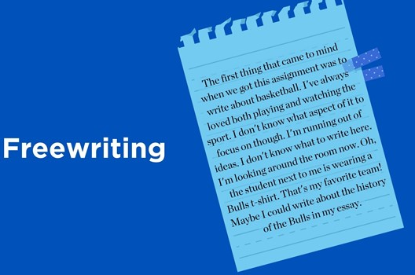
1. Thinking and Free-writing
Ideally, starting is one of the most challenging aspects of the writing task (Wasko, 2011), possibly because you realize that you have little to say about the topic or even have many random ideas trying to find expression simultaneously. Thus, you need to know the order to get them out or how to put them down.
The ideas should be written down in free form. To free write means to write without bothering whether what is written is correct or has any grammar, punctuation, spelling or structure errors. Some of us naturally do this without knowing it is called free writing. It is the way we write without first thinking about the correctness. We want to put down the ideas on paper or a computer screen first and randomly the way they come.
Think as you write and get the ideas out as many as possible and as fast as possible. It is the way to write when you find it challenging to think of tangible points on the topic.

Slide 5
Freewriting cont’d
Freewriting is your brain's ‘scribbling’ exercise to prepare it for actual writing work. Through this, you can write ideas that pop up in your mind about the topic. You can equally set a time – maybe 10 minutes – to do this.
You can do it repeatedly to generate several relevant points and discard the irrelevant ones.

Slide 6
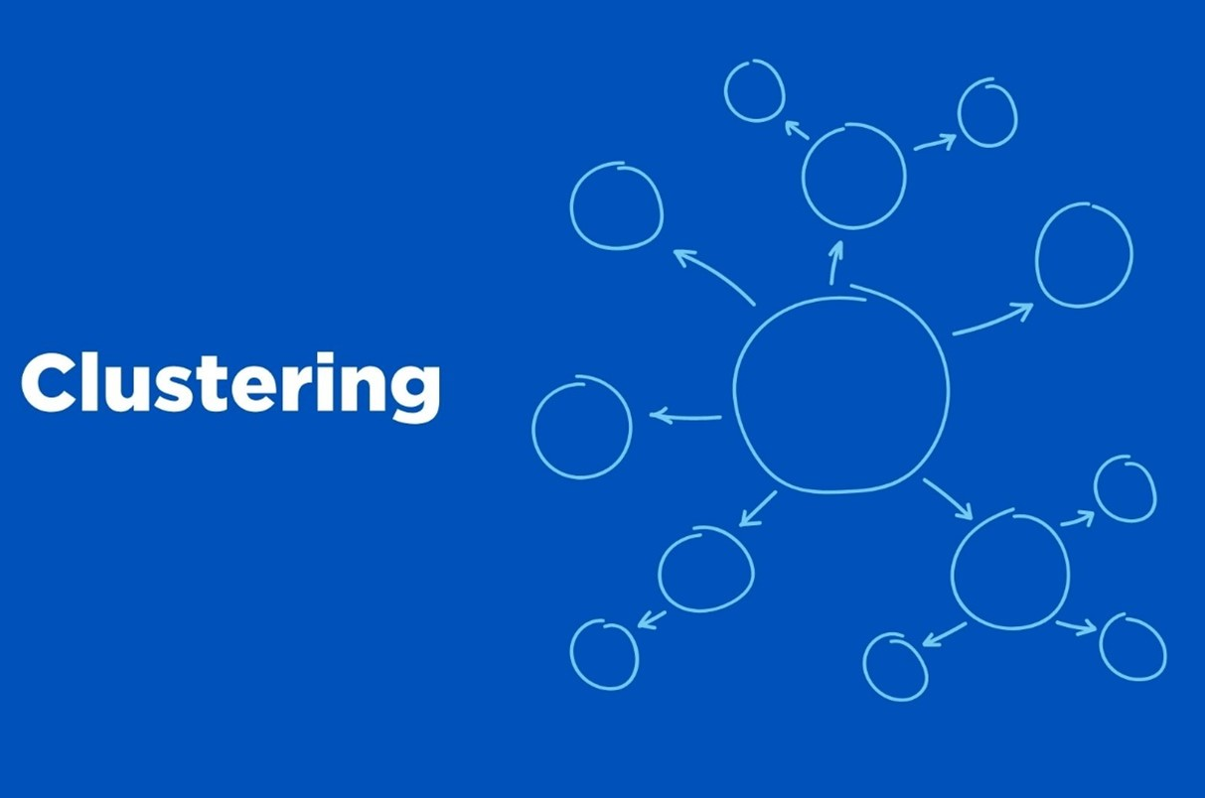
2. Clustering
In clustering, you represent your ideas on paper through graphics and show how each connects to the other.
You jot down ideas and use circles, squares, arrows or lines to show the connections. Some prefer calling this mind-mapping or diagramming.
You may start by writing down the central idea, and then you will be connecting other ideas to it as they come, using arrows.
It is an easy and graphic way to capture your thoughts on paper while showing how each idea is related to the others.
This is helpful because, most times, our thinking does not follow a straight line - unrelated thoughts come up between the related ones.
However, once symbols or arrows are used in connecting the ideas that are directly related to the topic, the less related ones might connect to the second layer.

Slide 7
3. Asking questions and seeking information
Asking questions about a subject of your writing is a useful step in getting appropriate information for your writing. When you come up with questions about the topic, it shows you are interested in knowing more about it.
Ask questions that start with ‘WH’ such as:
What issues do I want to know about the topic?
What are important areas in this topic?
Why is it necessary to know about the issues?
How am I going to find out?
Where and from whom do I get the information?
What will be the outcome of my writing?
Why is the outcome important to my readers?
How will I present this outcome or information in my writing?

Slide 8
Questioning
Depending on the topic, questions like these require reading from sources that will enrich your knowledge, such as books from the library and accurate information on the Internet.
Also, if you need more knowledge about the topic, you need to do some reading before you can even come up with questions. Visiting the library to get appropriate books on the topic, checking the Internet, visiting places like museums, and observing your environment provide you with the necessary information.

Slide 9

4. Outlining/listing
An outline is a list of the main ideas without the details. It would be best if you formed an outline before the actual writing.
An outline is vital for the following reasons:
It helps you to focus on the main ideas or facts of your writing.
It helps you to organize your work very well.
It helps you to have adequate facts before writing.
It helps you to see roughly the structure that your writing will take.
To prepare a good outline, you first come up with the topic to write on. For example, there are adverse effects of some chemicals used in cosmetics.

Slide 10
Outlining/Listing cont’d
The next thing is to brainstorm or think about the topic very well. Then, write down ideas. After that, you must organize the ideas you have written down correctly. Also, remove the ideas that are not relevant, and then be ready to develop your outline into paragraphs by adding more information to each of the points.
An outline has the following features.
It is arranged to show how the points connect in an orderly way: This means you let the most crucial point come up first, followed by the important one(s), and in that order.
It is usually written in sentences.
It contains keywords or examples to help you remember what you want to write about.
It serves as a rough draft or a summary of the contents of a piece of writing.

Slide 11
Outline cont’d
Format for outlines
Below is a simple outline of the adverse effects of some chemicals used for makeup cosmetics.
Adverse effects of make-up substances
Introduction: Definition /meaning - make-up substances are made of chemicals used chiefly by women to redesign the face and improve its beauty.
Body: Adverse effects
It causes skin allergies.
It causes skin cracking, peeling and blistering.
It makes the user suffer from excessive sweating.
It also makes the user suffer from severe odour.
Conclusion: A summary of all the points above.

Slide 12
Drafting
However, you will have to develop your outline to draft the essay.
You will need the knowledge of a good paragraph to build your points into a paragraph.
Write in one paragraph at a time.
A paragraph is a short part of a text, consisting of at least one sentence and beginning on a new line. It usually deals with a single idea or theme.
It is a sentence combination with a single theme and forms a section of the writing.
This means that in a writing wherein the writer intends to discuss five different ideas, they are expected to use at least five paragraphs, one for each idea.
Every good paragraph develops differently, usually with a beginning, middle and end.

Slide 13
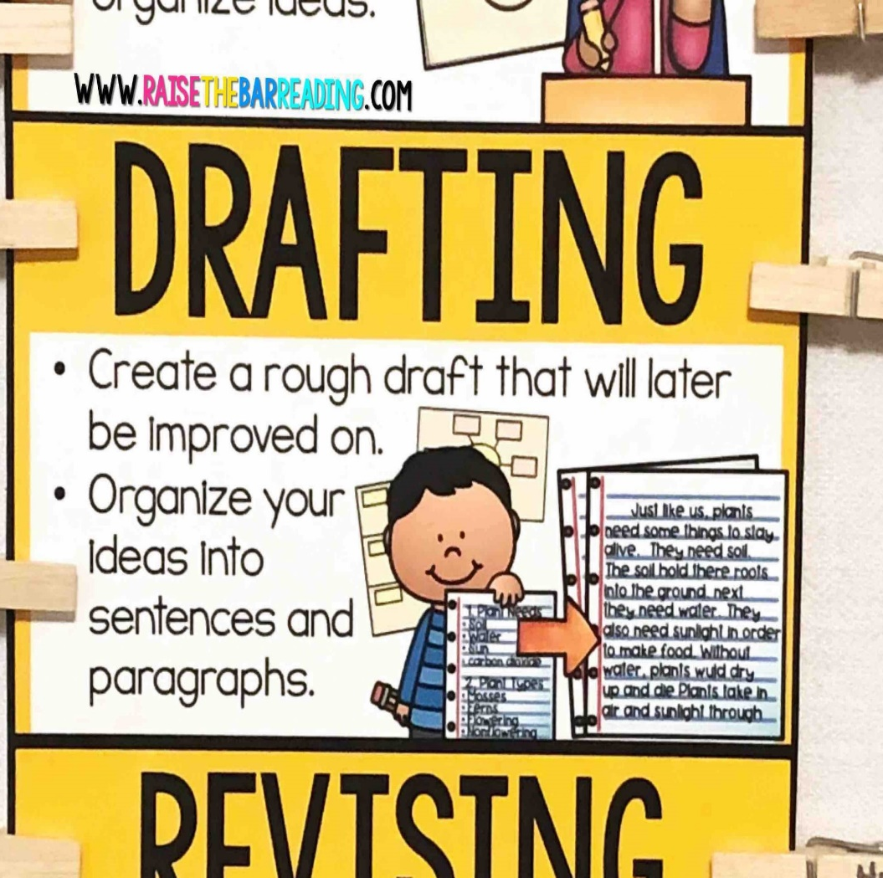
Drafting cont’d
Begin writing with the part you know the most about. You can start with the third paragraph in your outline if ideas come readily to mind. You can start with the second paragraph or the first paragraph, too. Try to write paragraphs longer than one sentence but shorter than the length of an entire double-spaced page.
Write one paragraph at a time and then stop. If you complete the assignment on time, you may choose how many paragraphs you complete in one sitting. Pace yourself. On the other hand, try not to procrastinate. Writers should always meet their deadlines.
Take short breaks to refresh your mind. This tip might be most helpful in writing a multipage report or essay. Still, if you cannot concentrate, take a break to let your mind rest.
Keep your audience and purpose in mind as you write. These aspects of writing are just as important when writing a single paragraph for your essay as when considering the direction of the entire essay.
Source: https://mlpp.pressbooks.pub/writingsuccess/chapter/8-3-drafting/

Slide 14
Drafting cont’d
The first version of your work is the first draft. And it is a rough draft.
Expectedly, this may look far from a well-furnished piece.
It is still part of the writing process.
You will then have to:
Add more points
Revise your thoughts
Delete some ideas
Organize your ideas
Restructure others
Develop better paragraphs
Sentence structure
These processes will produce second and even third drafts.

Slide 15
Revision and Proofreading
Make sure to leave plenty of time for editing and proofreading. In your proofreading, pay attention to the following:
1. Punctuation: Punctuation marks signal the structure of a text, showing where each idea begins and ends and how they relate to one another. Some of the most common grammatical mistakes can be fixed by adding, removing, or moving a punctuation mark.
Learn when to use commas and when a colon or semicolon is more appropriate.
Dashes and hyphens look similar but have different functions – avoid mixing them up and check that you’ve been consistent.

Slide 16
Proofreading cont’d
It’s important to avoid plagiarism in academic writing, so use paraphrasing or quotation marks every time you use someone else’s words. Check that you’ve used the right quotation marks, put other punctuation in the right place, and properly integrated the quote into your text.
Ensure you correctly use apostrophes to form the possessive with singular and plural nouns.
2. Capitalization: Capitalization rules in English require understanding the difference between common and proper nouns. Some of the most frequent errors in academic writing relate to capitalizing models, theories and disciplines.
The Influence of Parents on Children
You should also use a consistent capitalization style for titles and headings.

Slide 17
Proofreading cont’d
3. Sentence structure
Basic word order rules in English require a subject to be followed by a verb. Learn to avoid common sentence structure mistakes, such as fragments and run-ons. It would be best if you also tried to write sentences of varying length and structure.
Example of fragment: The restaurant offers many food. Such as rice, beans, plantain, and stew;
Example of run-ons: My favorite food is rice and beans; it is delicious.
It is nearly half past five we cannot reach town before dark.
To ensure the different elements of your sentences are appropriately balanced, follow the rules of parallel structure.
She was seen baking, washing and cooking at the same time.
Avoid confusingly structured sentences by learning how to fix dangling and misplaced modifiers.

Slide 18
Proofreading cont’d
4. Verbs
Verbs are the action words that tell us what happens in a sentence. Subject-verb agreement is essential to clarify who or what is doing an action.
Verb tenses locate an action in time. Make sure you use tenses correctly and consistently. The appropriate tense depends on whether you’re stating facts, making generalizations, describing the content of a text, reporting completed actions, or discussing events with ongoing relevance.
Phrasal verbs combine two or more words to create an entirely new meaning. They can be tricky to use and sometimes too informal for academic writing, so consider replacing them with one-word alternatives.

Slide 19
Proofreading cont’d
5. Word choice
There are some types of words that students often misuse or confuse. Examples:
(i) Articles: The two types of articles in English are definite (the) and indefinite (a/an). It’s essential to choose the right one to pair with a noun. The rules are different for single, plural, and countless nouns.
(i) Prepositions: Prepositions express relationships between different sentence elements (e.g. in, on, to, by, of, since). They can describe time, space, direction relationships, and many abstract or logical connections.
There are many different prepositions in English, and they often have more than one meaning. The only way to learn them all is through reading and practice.

Slide 20
Proofreading cont’d
(iii) Pronouns: Pronouns are words for nouns (e.g. they, it, him, this). Make sure it’s always clear what noun you are referring back to.
Avoid second-person pronouns (you, yours) in academic writing. First-person pronouns (I, we) are sometimes acceptable depending on the discipline and type of document.
(iv) Conjunctions: Conjunctions are words that connect different parts of a sentence. There are various types of conjunctions with other functions and rules.
(v) Commonly confused words
Some words are commonly confused or misused, including this/that, which/that, who/whom, affect/effect, and different forms of the word research. Learn more about how to tell the difference between them.

Slide 21
Reference
https://www.scribbr.com/category/language-rules/
Thank you!

