Slide 1
Citations

Slide 2
What IS A citation?
The acknowledgment that you make to work/literature that has been used in your writing.
When you give credit to ideas, texts, books, papers, research, media, and any other sources of information that you have directly or indirectly used in your work.
The way you tell your readers that specific material came from another source.
It gives your readers the information necessary to find that source again.
If you do not cite your information sources, that is plagiarism.
Citing your sources not only acknowledges the work of others, but also enhances the credibility of your own work.

Slide 3
When do I need to cite?
Whenever you use quotes.
Whenever you paraphrase or summarize and idea from someone else.
Whenever you have relied heavily on another work to help you write your paper.
Two Types of Citations
Citations give your readers two important kinds of information:
Exactly where in your paper you have used other sources (in-text citations)
All the bibliographic information they would need to find the source themselves (references/works cited).

Slide 4
What do you need to cite?
The information needed for a book citation is:
Author
Title
Publisher
Place of Publication
Date
Information needed for an article citation:
Author
Title of the article
Name of the journal
Issue information
(can be month, year, volume, issue, pages)

Slide 5
In text citations
In general, in-text citations are made when you:
Quote an author
Paraphrase an author/text
Summarize a text

Slide 6
Common referencing styles
The American Psychological Association (APA Style): used in discipline such as the sciences, psychology, education, social sciences and few parts of humanities. It is in currently in its 7th Edition.
Modern Language Association (MLA Style): used largely in the humanities—language, history, music, literature, religious studies, etc. Currently in its 8th edition.
Chicago: common with Law discipline. It uses notes (footnotes and endnotes)

Slide 7
Author-date citation system in APA and MLA
That is, you cite the name of the author and the data in your paraphrase paragraph, quoted expressions, or summarized expressions.
Paraphrasing
This is expressing another person’s idea in your own words. Paraphrases allow you to condense information and synthesize ideas from multiple source. Get use to paragraphing!
(i) Parenthetical in-text citation:
Example:
The social media threaten the moral development of children (Karas, 2020).

Slide 8
(ii) Narrative in-text citation:
- Karas (2020) notes that social media threatens the moral development of children.
- According to Karas (2020), social media threatens the moral development of children.
- As Karas (2020) states, social media threatens the moral development of children.
- In Karas (2020), the author stresses that the social media threaten the moral development of children.

Slide 9
Signal words and Author Verbs
A signal word or phrase in your text helps your reader know you are about to give them information that came from another source.
According to_________,
As _________ states,
In ________________ (text), the author explains_______

Slide 10
Author verbs
Acknowledged | Believed | Declared | Granted
Observed | Reported | Added | Claimed
Denied | Illustrated | Responded | Commented
Pointed out | Suggested | Addressed | Compared
Disputed | Argued | Confirmed | Emphasized
Refuted | Thought | Asserted | Rejected
Wrote | Stated | Highlighted | Discussed
Sommers (1998) observed that….
In the article, Lusher illustrated the difference between….

Slide 11
Let’s Look at how we format in-text citations…

Slide 12
General rules for paraphrasing
APA: Whenever you use a source, provide in parenthesis: the author’s name and the date of publication (Sclama, 2017).
MLA: Whenever you use a source, provide in parentheses: the author and page number (Sclama 67). If you mention the author in the sentence, you do not need to repeat it in the parentheses / brackets.

Slide 13
IN-TEXT CITATIONS: paraphrases
Author
Author
 | APA | MLA
SHORT QUOTES | According to Jones (2021), Year-one students usually find it difficult to cope with the university science programs. Year-one students usually find it difficult to cope with the university science programs (Jones, 2021) | Jones states that year-one students usually find it difficult to cope with the university science programs (23) Year-one students usually find it difficult to cope with the university science programs (Jones)
Year
Page Number
Author
Year

Slide 14
Direct quotation
Always use paraphrase.
Avoid quotation or quote sparingly. Reserve quotes for vivid, impactful language
For direct quotes of fewer than 40 words, use the author- date citation system, include a page number (p. or pp.) and put the quote inside the paragraph.

Slide 15
IN-TEXT CITATIONS: Short Quotes
Author
Author
 | APA | MLA
SHORT QUOTES | According to Jones (1998), "First year students often had difficulty in university-level science classes" (p. 199). She stated, "First year students often had difficulty in university science classes" (Jones, 1998, p. 199), but she did not offer an explanation as to why. | Wordsworth stated that Romantic poetry was marked by a “spontaneous overflow of powerful feelings” (263). Romantic poetry is characterized by the “spontaneous overflow of powerful feelings” (Wordsworth 263).
Year
Page Number
Page Number
Author
Page Number
Page Number
Year
Author

Slide 16
More examples
Identify the style (s) below?
Narrative:
According to Balowe (2020), “human mind is extremely elastic and can accommodate as much as you allow it” (p. 270).
Parenthetical:
Essentially, “human mind is extremely elastic and can accommodate as much as you allow it” (Balowe, 2020, p. 270).

Slide 17
IN-TEXT CITATIONS: LONG QUOTES
Block quotes (of 40 words or more): Do not use quotation marks. Start the quotation on a new line indented .5 in from the left margin. Double space the block quotation. The parenthetical reference goes after the final period.
APA example
Researchers have studied how people talk to themselves:
Inner speech is a paradoxical phenomenon. It is an experience that is central to many people’s every day lives, and yet it presents considerable challenges to any effort to study it scientifically. Nevertheless, a wide range of methodologies and approaches have combined to shed light on the subjective experience of inner speech and its cognitive and neural underpinnings. (Alderson-Day & Fernyhough, 2015, p. 957)

Slide 18
MLA example
Researchers have studied how people talk to themselves:
Inner speech is a paradoxical phenomenon. It is an experience that is central to many people’s every day lives, and yet it presents considerable challenges to any effort to study it scientifically. Nevertheless, a wide range of methodologies and approaches have combined to shed light on the subjective experience of inner speech and its cognitive and neural underpinnings. (Alderson-Day & Fernyhough 957)

Slide 19
More examples of LONG QUOTES
 | APA | MLA
Long Quotes (40+ Words) | Jones's (1998) study found the following: Students often had difficulty using APA style, especially when it was their first time citing sources. This difficulty could be attributed to the fact that many students failed to purchase a style manual or to ask their teacher for help. (p. 199) | Nelly Dean treats Heathcliff poorly and dehumanizes him throughout her narration: They entirely refused to have it in bed with them, or even in their room, and I had no more sense, so, I put it on the landing of the stairs, hoping it would be gone on the morrow. By chance, or else attracted by hearing his voice, it crept to Mr. Earnshaw's door, and there he found it on quitting his chamber. Inquiries were made as to how it got there; I was obliged to confess, and in recompense for my cowardice and inhumanity was sent out of the house. (Bronte 78)
Indent the entire block quote, no quotation marks
Indent the entire block quote, no quotation marks

Slide 20
IN-TEXT CITATIONS:
Summarize and Paraphrase
Signal Words
Signal Words
 | APA | MLA
 | According to Jones (1998), APA style is a difficult citation format for first-time learners. APA style is a difficult citation format for first-time learners (Jones, 1998, pp. 199-200). | Sommers had expressed that the market changed in the 17th century (91-92). The literature also indicates (Hamilton and Spruill 231) that modest improvements have been made to training programs. Wordsworth extensively explored the role of emotion in the creative process (263).

Slide 21
Practice A (APA Style)
Author: Michael Bestoff Title: “Cell Phone Use and Collision Risk” Year: 2004 Page: 54
1. A recent study found that drivers using cell phones were up to four times more likely to have accidents than those not using these devices ( ). | 3. A recent study concluded that “using a cellular telephone increased the risk of having a motor vehicle collision as much as four times for the same drivers when they were not using their cellular telephones” ( ).
2. Bestoff’s ( ) study proves that drivers using cell phones were up to four times more likely to have accidents than those not using these devices. | 4. Bestoff ( ) concluded that “using a cellular telephone increased the risk of having a motor vehicle collision as much as four times for the same drivers when they were not using their cellular telephones” ( ).
D
A
C
D
B
A. Bestoff, 2004, p. 54
B. p. 54
C. 2004
D. Bestoff, 2004

Slide 22
UN-PAGINATED SOURCES
Provide a heading or section name
  Use an abbreviated name in quotes if the section name is too long
APA: (Gecht-Silver & Duncombe, 2015, The Behaviour section).
MLA: (Gecht-Silver & Duncombe, Osteoarthritis section).
Provide a paragraph number (count manually if not numbered)
(Chamberlin, 2014, para. 1).
Provide a timestamp for beginning of material quoted from audio/visual sources
Song/videos/YouTube: (Weird, 2019, 2:12)

Slide 23
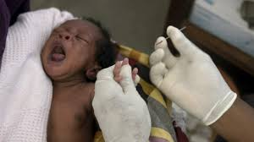
Images, Figures and Tables
Image 1: African children diagnosed of Malaria
Source/Image Credit: The United Nations, 2023

Slide 24
Multiple Authors
One or two authors: include the names of both authors in every in-text citation
Narrative: Jones and Kim (2019) reported that …
Parenthetical: (Jones & Kim, 2019).
Three or more authors: include the name of only the first author plus “et al.” in every citation, including the first (unless this would create ambiguity)
Narrative: Jones et al. (2019) found that the effects of …
Parenthetical: (Jones et al., 2019).

Slide 25
UNKNOWN AUTHOR ORGANIZATION AS AUTHOR
Unknown author: include the title and year of publication
Narrative: In 2015, Tech Seeds reported that “5 million of Africans in diaspora are now into fintech businesses” (p. 30)
Parenthetical: (Tech Seeds, 2015, p.30).
Organization as author: name the organization and year of publication
According to the International Society for Technology in Education (ISTE) (2016),
ISTE (2016) also indicated that….
… First citation: (Food and Drug Administration [FDA], 2012)
Later citations: (FDA, 2012)
(FDA, ibid)

Slide 26
TWO OR MORE WORKS IN THE SAME PARENTHETICAL REFERENCE
When citing multiple works in the same parenthetical reference, place the citations in alphabetical order, separating them with semicolons.
Example:
Social media is changing human behaviour, dictating the direction of lives and orchestrating what humans never had thought would happen (James & Graham, 2020; Lindo et al., 2021; Weird, 2019).

Slide 27
Listing your sources: Last Page
In APA: “References”
In MLA: “Works Cited”

Slide 28
References/ Works Cited Pages
General formatting:
  All lines after the first line of each entry in your
  reference list should be indented one-half inch
  from the left margin. This is called hanging
  indentation.
  Arrange the list of references alphabetically.
  Each reference should be double-spaced.

Slide 29
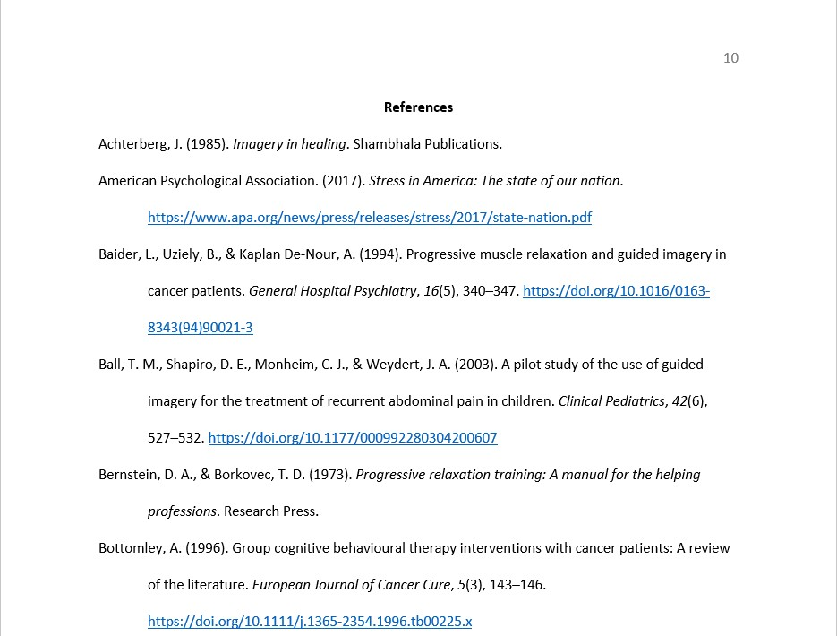
APA: References
“References” centered and bolded
Entries arranged in alphabetical order with hanging indent

Slide 30
Reference elements
Punctuation:
  Put a period in between reference elements
  Use commas to separate parts of an element
  Capitalize the letter of titles, subtitles (after the : ), and proper names
Author: the person or group responsible for creating, writing, or editing the content of a work
Date: date of publication
Title: the title of the work being cited
  Stand-alone titles: book, journal, website, report
  Part of a greater whole: article, chapter
Source: where readers can retrieve the work cited (journal, website, publisher)
  URLs and DOIs: present both as hyperlinks
  Accessed date for URLs

Slide 31
Citing a book
Authored book (with multiple editions, with or without a DOI)
Author(s)’s last names, initials. (year). Title of book: Subtitle (2nd ed.). Publisher’s name. Place of publication/ DOI
Burgess, R. (2019). Rethinking global health: Frameworks of power. Routledge. London
Burgess, R. & Rule, A. (2019). Rethinking global health: Frameworks of power. Routledge. London
Brown, L. S. (2018). Feminist therapy (2nd ed.). Routledge. https://doi.org/10.1037/0000092-000

Slide 32
Citing a journal
Article with a DOI or URL (if given both, choose the DOI)
Author, A. A. & Author, B. B. (year). Title: Subtitle. Journal Title/name, Volume(issue), pages number. DOI.
McCauley, S. M., & Christiansen, M. H. (2019). Language learning as language use: A cross-linguistic model of child language development. Psychological Review, 126(1), 1-15. https://doi.org/10.1037/rev0000126

Slide 33
Citing online sources: weblogs, posts, website, videos/audios (e.g. YouTube)
Author’s last name, initials. (Year, Month, day that it was published or updated – if unavailable, use write Undated). Title: Subtitle of the articles (if not found, substitute this with the name of the website/blog). URL/link of the source. Accessed date
Example of website/weblog)
Overo, N. (2022, May 2). Here are 5 sustainable Nigerian fashion brands. https://culturecustodian.com/here-are-5-sustainable-nigerian-fashion-brands/ Accessed February 8, 2023
Kay, L. (Undated). Here are 5 sustainable Nigerian fashion brands. https://culturecustodian.com/here-are-5-sustainable-nigerian-fashion-brands/ Accessed February 8, 2023
Example from YouTube Video
Weird J. (2020). Project planning for beginners – Project management training. https://youtu.be/00rzg3y6hJc. Accessed February 8, 2023
Girdler, A. (2021). How to write a project plan: Project planning steps that work. https://youtu.be/Lt9_4vzPdlo. Accessed February 8, 2023

Slide 34
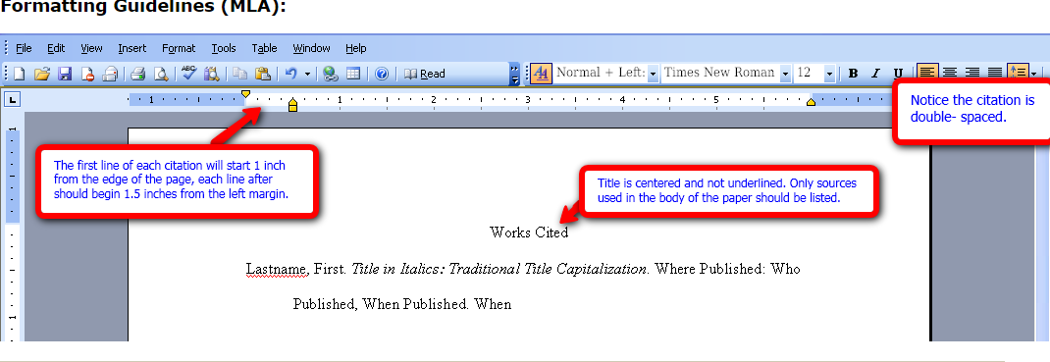
MLA Format: Works cited

Slide 35
MLA’s works cited cont’d.
Book
Journal Article
Website

Slide 36
FORMAT: MLA Book
Author(s)’s last and first name, Author(s)’s middle name as initial (if available). Title in italics. Where published/place of publication: Who published/publisher’s name. year of publication/when published
Example
Adams, Ansel, L. An autobiography. Boston, MA: Little & Brown. 1985.

Slide 37
FORMAT: MLA JOURNAL ARTICLE
Author(s)’s last and first names, Author(s)’s middle name as initials (if available). Title of article (in quotes). Name of the journal (in italics, first letter of all principle words capitalized). Volume number. Issue number (Year of publication): page numbers. DOI
Coman, Marcia J. and Kathy, Heavers. “Social class and college costs: Examining the financial nexus between college choice and persistence.” The Journal of Higher Education, 73. 2 (2002): 89-236.

Slide 38
FORMAT: MLA Website
Author(s)’s last and first names, middle name as initial (if available). “Title of article in quote”. Name of the website. Date (month and year) of publication or date last updated—if not found, write n.d. (no date). URL/link. Date accessed
Website Example
Kenneth, Iron .A. “A Buddhist response to human
rights”. Buddhist Ethics. January 2016. http://www.cac.psu.edu/jbe/twocont.html. Accessed February 3, 2017.

Slide 39

PRACTICE: Sample Book
Developing Study Skill, Taking Notes and Tests, Using Dictionaries and Libraries.
Marcia J Coman and Kathy L. Heavers,
NTC Publishing Group,
Lincolnwood, Illinois,
1998
The information needed for a book citation is:
Author
Title
Publisher
Place of Publication
Date

Slide 40
Sample book citation (the answer)
APA Format
Coman, M. J. & Heavers, K. L. (1998). Developing study skills, taking notes and tests, using dictionaries and libraries. 2nd Ed. Lincolnwood, IL: NTC Publishing Group.
MLA Format
Coman, Marcia J. and Kathy Heavers. Developing Study Skills, Taking Notes and Tests, Using Dictionaries and Libraries. Lincolnwood, IL: NTC Publishing Group, 1998.
.

Slide 41
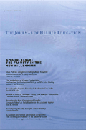
Practice journal article
Journal of Higher Education
Social Class and College Costs: Examining the Financial Nexus Between College Choice and Persistence
by Michael B. Paulsen and Edward P. St. John
March/April 2002, vol 73 issue #2
Information needed for an article citation:
Author
Title of the article
Name of the journal
issue information
(can be month, year, volume, issue, pages)

Slide 42
Sample journal article citation
(the answer)
      APA Format
      Paulsen, M. B. & St. John, E. P. (2002). Social class and college
      costs: Examining the financial nexus between college choice
      and persistence. The Journal of Higher Education, 73(2), 189-
      236.
      MLA Format
      Paulsen, Michael B. and Edward John. “Social class and
      college costs: Examining the financial nexus between college
      choice and persistence.” The Journal of Higher Education,
      73 (2002): 189-236.

Slide 43
Practice : APA or MLA
Book
Author: Humez, Jean McMahon
Title: Harriet Tubman : the life and the life stories
Publisher: Madison, Wis. : University of Wisconsin Press, 2003.
Article
Authors: Cosio MQ; Taylor GW
Title: Soda pop vending machine injuries: an update.
Journal: Journal of Orthopaedic Trauma 1992; Vol. 6, pp. 186-9.

Slide 44
References
Plagiarism.org
Purdue
http://www.roanestate.edu/owl/mla-format4websites.htm
http://www.sbcc.edu/clrc/writing_center/wc_files/wsw/Writing%20Sk%20Wksp%20APA%20Fall%202016.pdf
Cartwright Learning Resources Center—Damjanovich, N. and Carey, E.

