Slide 1
Understanding Mechanics
WRI 101

Slide 2
LEARNING OUTCOMES
By the end of this presentation, students should be able to:
State the uses of capitalization
Indicate the functions of the various punctuation marks treated,
Explain purpose, tone, and audience in writing

Slide 3
CAPITALIZATION
Capitalize:
The first word in a sentence. He is my friend.
Proper nouns: Yola, American University of Nigeria, January, Hausa, Fulani, President, etc.
The first word in a title and every lexical word, for example , Things Fall Apart; do not capitalize grammatical words (articles, pronouns, prepositions , and conjunctions

Slide 4
CAPITALIZATION
Capitalize:
the pronoun I
Adjectives that are derived from proper nouns, examples are Nigerian, American, etc.
Academic grades: I got a B in algebra. (MLA)
A title that precedes a name, for examples, President Tinubu, Dean Fay, etc.

Slide 5
CAPITALIZATION
Capitalize:
the first word of a direct quotation: The manager said, “She’ll come.”
Historical events include World War I, the Nigerian Civil War, International Women’s Day, and the International Day of the African Child.
Brand names: Nike, Adidas, Harrods, etc.

Slide 6
CAPITALIZATION
In title case, capitalize the following words in a title or heading:
the first word, even a minor word such as “The”
the first word of a subtitle, even if it is minor
the first word after a colon or end punctuation in a heading, even if it is a minor word
major words, including the second part of hyphenated major words (e.g., “Self-Report,” not “Self-report”) (APA)

Slide 7
CAPITALIZATION
Do not capitalize:
A foreign name that begins with a lower case, for example, van de Biyer, etc.
A proper noun that starts with a small letter such as iPad, eBay, etc. (APA, 7th Session)
A title that does not precede a name or is used generally, for example, Professor Fay is the dean of School of Arts and Sciences.

Slide 8
PUNCTUATION MARKS
They are used to indicate the meaning of a grammatical structure.
They establish the cadence of a sentence
They express the grammatical function of a particular structure.
Is the structure a question, statement, or exclamation?
Different manuals of style have guidelines for punctuation, but some may vary.
Common referencing styles include the Modern Language Association of America (commonly MLA) and the American Psychological Association (APA).

Slide 9
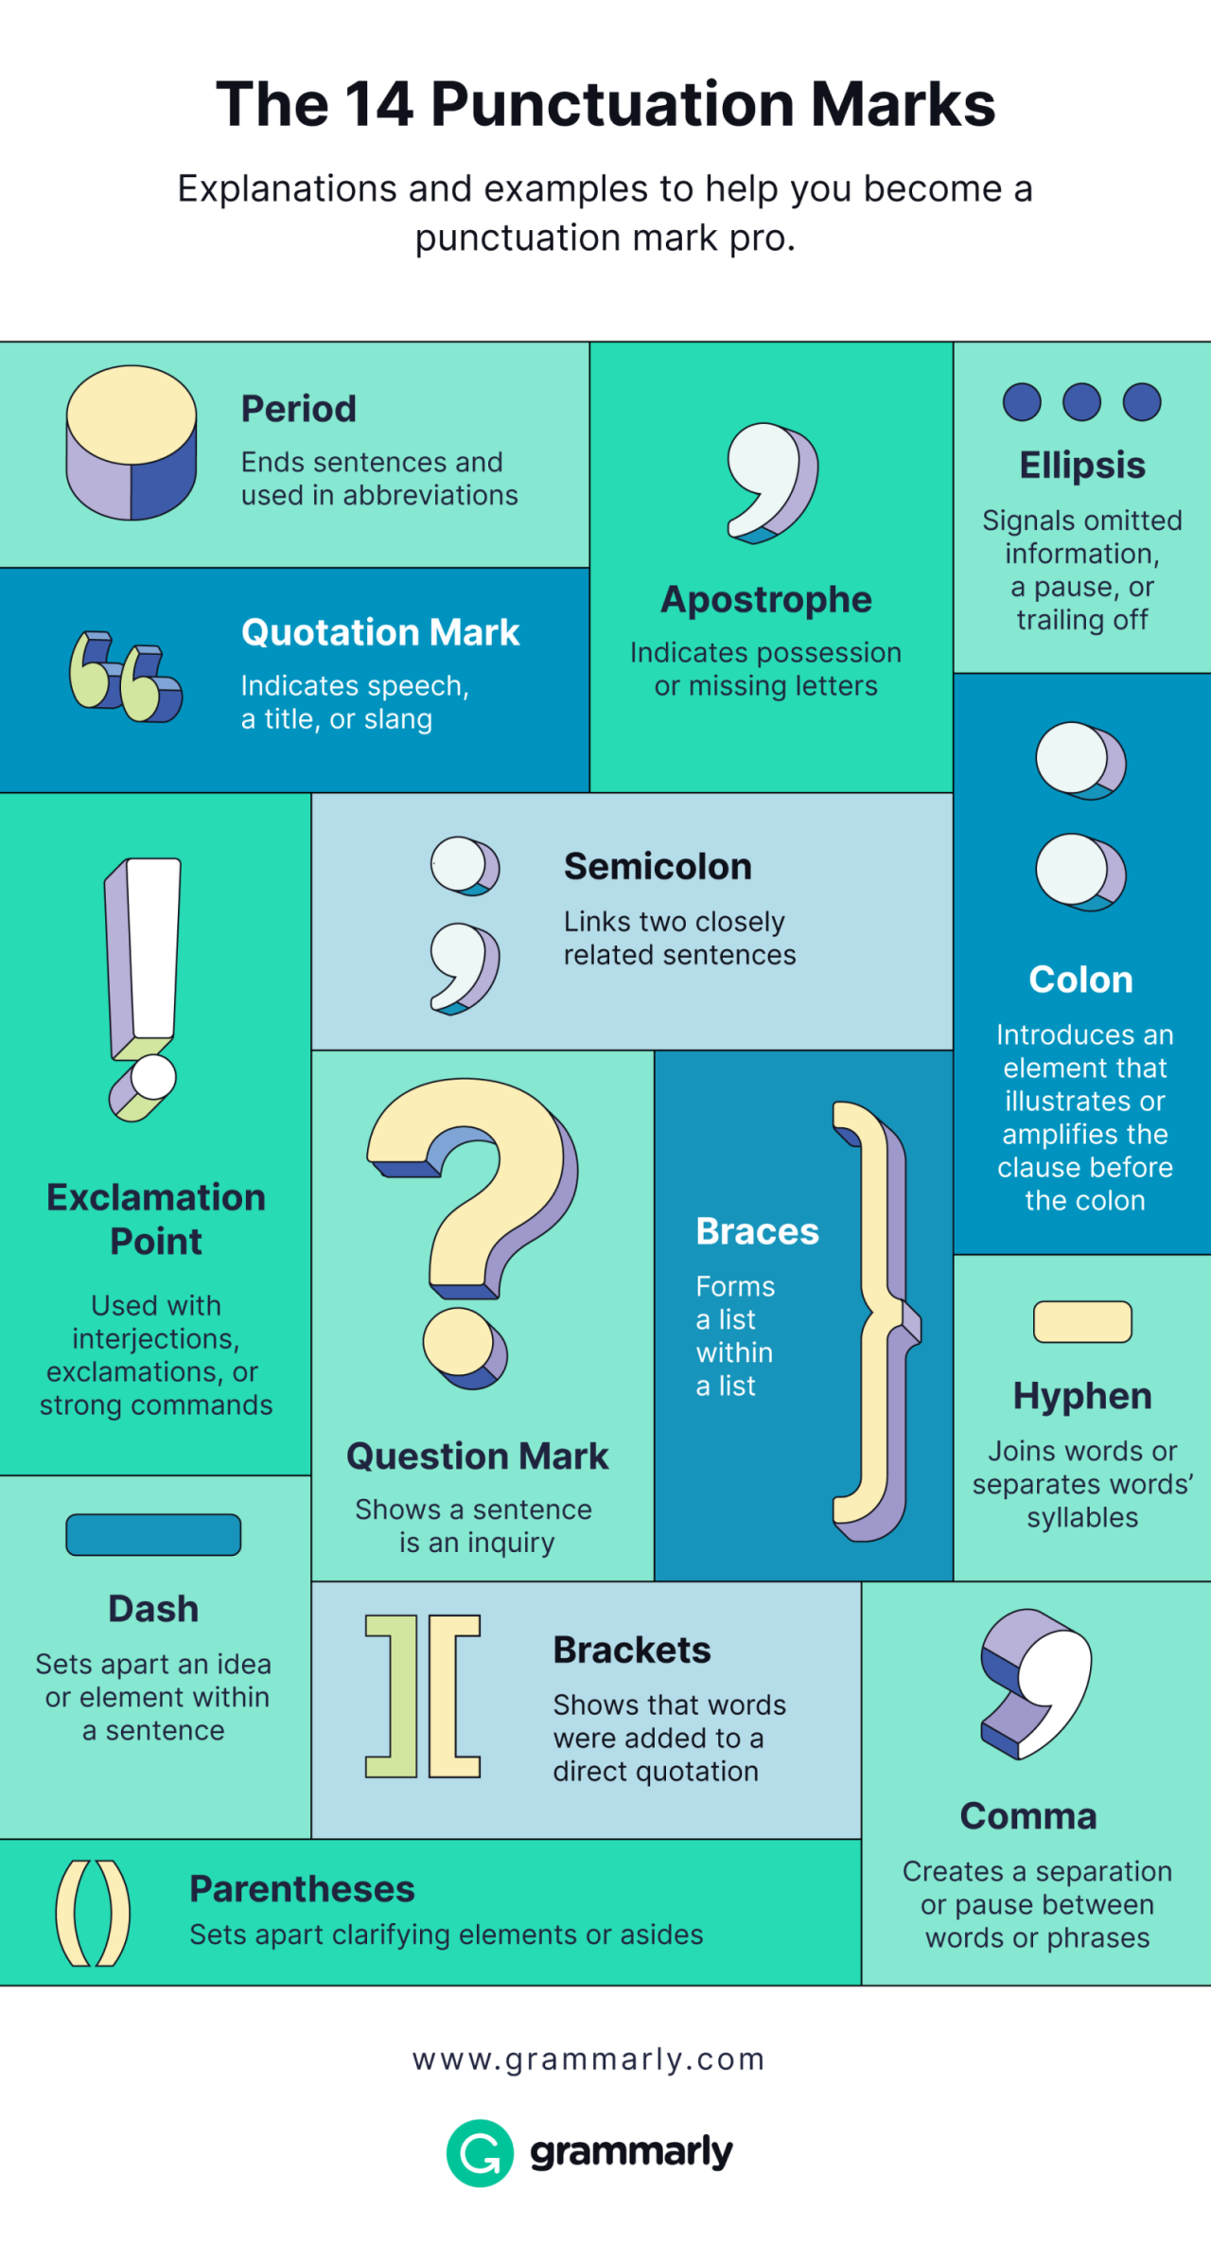

Slide 10
USES OF A COMMA (,)
Using commas is sometimes controversial, and there is no agreed-upon set of rules (Sandra Scary and John Scary, 2005).
Grey areas include using a comma before coordinating conjunctions (and, but, or).
She is my friend, but I do not appreciate her. (US)
She is my friend, but I do not appreciate her (British)
British English does not support a comma before “and,” but other styles of grammar support it (when coordinating a sentence).

Slide 11
USES OF A COMMA (,)
A Comma serves as a pause.
He bought toys, fruits, and a golden pen to separate three or more items in a sequence.
In British English, commas can separate clauses, but semicolons are preferable in American English (to prevent comma splices). Examples:
The sea was shining, the beach was empty, and Anne felt at peace. (Marion Field 2009)
She saw the movie last week; she wrote a review this week.

Slide 12
USES OF A COMMA (,)
To separate adjectives that qualify a noun: This is my favorite, green coat.
Avoid a comma when the adjectives are often used together. For example, He took a long hot bath. (GSBE)
To set off dates (note the difference between British and American styles of writing dates), addresses, and geographical names: Today is Monday, March 18, 2024.
Monday, 18 March 2024 (British)
I study English at the American University of Nigeria, Yola, Adamawa.

Slide 13
USES OF A COMMA (,)
After a dependent clause that starts a sentence:
Although she came late for the test, she passed excellently.
The position of a comma can change the meaning of a grammatical structure (Field 2009).
As mentioned, first impressions can be misleading.
As mentioned first, impressions can be misleading.
When addressing a person by name: Caine, where are you?
To separate direct speech: ‘I can’t,’ she replied.

Slide 14
USES OF A COMMA (,)
To set off parenthetical comments
His statement, I observed, was erratic.
Culture in African culture, I submit, should be pluralized.
After an introductory phrase (if the introductory phrase is short, the comma after it is optional):
          In this section, we discuss punctuation
          or
          In this section, we discuss punctuation.

Slide 15
USES OF A COMMA (,)
To indicate contrasting phrases
The student, not the teacher, reviewed the article.

Slide 16
INCORRECT USE OF A COMMA (,)
Using a comma between a subject and a verb:
What makes the movie interesting is the suspense (Incorrect)
But you can have
Tade Ipadeola, who wrote The Sahara Testaments, won the 2013 NLNG Prize for Literature. (Nonrestrictive relative clause)
Between a verb and an object
The lady said that she would return the next day. (Incorrect)

Slide 17
USES OF A SEMICOLON (;)
to separate two independent clauses that are not joined by a conjunction
The students wrote the test quickly; the teacher left after the test.
to separate items in a list that already contains commas
The color groups were red, yellow, and blue; orange, green, and purple; or black, gray, and brown. (APA)
to separate multiple parenthetical citations
Gaddis, 2018; Lai et al., 2016; Williams & Peng, 2019 (APA)

Slide 18
USES OF AN APOSTROPHE (’)
To indicate possession: singular – Janet’s bag, Fatima’s purse, Audu’s pen, dog’s tail;
Plural – in irregular plurals, add ‘s: children’s toys, women’s bags
In regular pluralization, add the apostrophe after the ‘s’: ladies’ pen, brothers’ clothes
To indicate contraction: I’ll, she’ll, let’s, etc.
To form the possessive of nouns in a series, add a single apostrophe and an s if the ownership is shared Audu and Fatima’s car, etc.
But if the ownership is separate, place an apostrophe and an s after each noun. For example, Audu’s and Fatima’s cars, etc.

Slide 19
USES OF AN APOSTROPHE (’)
Use an apostrophe to form the plurals of letters (MLA).
The word accommodation has two c’s and two m’s.
Use an apostrophe to form the plurals of letter grades.
She got three A’s this semester.
Do not use an apostrophe to form the plural of an abbreviation or a number. Correct examples are PhDs, 1960s, fours, etc.

Slide 20
USES OF A HYPHEN (-)
A hyphen divides a word at the end of a line (should be according to syllables): ed-u-ca-tion
A hyphen connects compound words (use a dictionary as a guide): brother-in-law, empty-handed, far-fetched, etc.
A hyphen denotes the syllabification of words (in dictionaries).
A hyphen connects a phrase that modifies a noun. For example, the five-year-old girl
A hyphen connects compound numbers, dates, or fractions, such as twenty-five, 9-3-2024, two-thirds, etc.

Slide 21
DO NOT HYPHENATE
Do not hyphenate an adjective that includes an adverb ending in –ly (MLA)
a thoughtfully presented argument
Fractions used as nouns (APA): Two-thirds of the students are here.
However, MLA recommends using a hyphen in simple fractions, no matter their part of speech. For example, He watched only one-third of the movie.
No hyphen is needed in a compound adjective with a comparative or superlative description formed with less, least, more, or most. For example, the less expensive option

Slide 22
DO NOT HYPHENATE
When you are writing for a specialized field, no hyphen is needed in a common compound adjective. For example, second language acquisition, Black American vernacular, etc.
A hyphen is not needed for a foreign-language adjective or phrase. For example, ad hoc, sine qua non, sui generis, etc.

Slide 23
ITALICS
Italics are slanted letters.
They are used to emphasize a word, phrase, or clause. For example: The uses of the comma remain controversial among scholars.
They indicate the title of a book. For example: Chinua Achebe’s Things Fall Apart is an African classic.
Italics indicate loan/foreign words. For examples: sui generis, étagère, etc.
To express biological terms, for example, Homo sapien, Cebus apella

Slide 24
DO NOT USE ITALICS FOR THE FOLLOWING
Titles of book series (e.g., the Harry Potter series)
The punctuation mark after an italicized word or phrase
Who is the author of Things Fall Apart?
Note: Italicize a punctuation mark that is part of an italic element, such as a colon, comma, or question mark within a book title, periodical title, or heading (APA).

Slide 25
ABBREVIATIONS
It is a shortened word of a word or phrase.
To maximize clarity, use abbreviations sparingly and consider readers’ familiarity with the abbreviation.
Acronyms are treated similarly in some cases (APA): abbreviations of phrases are often composed of the first letter of each word of the phrase (i.e., acronym) – APA
Acronyms are recommended after the first use. For clarity, use the full description and the acronym at the first instance. For example, American University of Nigeria (AUN), then AUN subsequently

Slide 26
REVISION IN THE WRITING PROCESS
Revision is an essential part of the writing process.
Revision entails making changes at any point in the writing process (Fitzgerald 1987)
Your initial writing should be regarded as a draft.
Revision may be done alone, with a group, peer tutor, or directly with your instructor.
The best revision starts with you.
Revision makes the draft more accessible, transparent, coherent, and thought-provoking.

Slide 27
REVISION IN THE WRITING PROCESS
Hayes and Flower model of writing distinguishes between reviewing and revising.
Reviewing as a mental process of evaluating what has been written and revising as the physical modifications based on the mental process (Lucile Chanquoy)
Generally, revision is both a mental and a physical process.
The mental process compares the mental representation of the intended text, while the physical entails reading, rewriting, and editing.

Slide 28
SOME PROCESSES OF REVISION
Deletion
Substitution
Shifting
Reorganization
The levels of these processes can be at the word, phrase, sentence, or ideation level.

Slide 29
REVISION STRATEGIES OF INEXPERIENCED WRITERS
Rewording: Using better words and eliminating those that are wordy or redundant; it is designated a thesaurus philosophy of writing (Nancy Sommers)
Most students feel revision entails only rewording.
They sometimes add transitions.
Most times, they neglect the credibility of their argument.

Slide 30
REVISION STRATEGIES OF EXPERIENCED WRITERS
They check the form or shape of their argument.
They check patterns of development in their revision of the draft.
They move from the first draft to the second and third until the final writing.
They check the nexus/link between the main argument and the sub-arguments.
Rewriting their draft is a constant process of the revision strategy.

Slide 31
REVISION STRATEGIES OF EXPERIENCED WRITERS
They imagine readers’ perspectives to enrich their revision. They consider the sociocultural factors, gender, etc., that may influence readers’ perceptions.
They concentrate on sentence-level or paragraph-level revision by addition and deletion.
The revision process is holistic. It entails the form, balance, rhythm, or communication.
Revision as beginning over again

Slide 32
CATEGORIES OF REVISION STRATEGIES
Self-Revision: Personal revision
Peer Revision: Revision by friends
Teacher/Mentor Revision
Gatekeeping Revision (Journal Editors, Skilled Academics, etc.)
Computer-assisted Revision

Slide 33
REVISION STRATEGIES: SELF-REVISION
Check your argument and the main idea of the writing.
Check the structure of your work: introduction-body-conclusion link
Examine the connection between the language and the argument. Does your vocabulary support your argument? Is your diction appropriate?
Examine your sentences: Are they varied? Or monotonous?
Proofread your work.
Rewriting should be a constant part of the process, whether as a whole or in part.

Slide 34
REVISION STRATEGIES: SELF-REVISION
Develop a holistic process towards revision, from words to sentences to paragraphs and the whole piece
Recognize the audience’s perspective.
Revisions should be continuous.
Peer revision is a cardinal part of your revision strategy.
Mentor/Teacher feedback (formative assessment) on students’ writing

Slide 35
REVISION THROUGH PEER EVALUATION
You can have others read your work as part of your revision strategy.
They can provide feedback on your writing regarding the coherence of the work.
They can assess the strength and validity of your argument.
Assess the connection between your thesis and the sub-arguments.
They can help identify grammatical errors.
Always share your writing with your trusted peers for cross-fertilization of ideas and improvement of your writing.

Slide 36
PURPOSE IN WRITING
The purpose of writing differs.
It is a writer’s reason for writing a piece. The “why” of a piece.
The basic purposes include to describe, entertain (narrate), argue/persuade, evaluate, summarize, analyze, etc.
Other purposes include: academic, literary, formal, informal, etc.

Slide 37
TONE
Your purpose will determine your tone.
The tone is how you write about a subject.
Your tone may be critical, reflective, humorous, formal, or informal.
Your diction, vocabulary level, and sentence structure determine your tone.
Formal writing, such as academic writing, requires a formal tone that conveys professionalism.
Establishing a tone that conveys the essential points of your work interestingly will engage readers and communicate your ideas effectively.

Slide 38
AUDIENCE
Your audience is the prospective reader of your writing.
Your audience determines the sophistication of your writing style.
Your readers will determine your language style, vocabulary level, register, formality, informality, etc.
Before writing, you must consider the demographics (age, gender, etc.), prior knowledge, level of education, and expectations of your reader/audience. For example, children's literature is different from a college novel.
Your audience determines your purpose and your tone.
Write in a way (tone) to inform and persuade your reader (audience)

Slide 39
ELEMENTS OF EFFECTIVE SCHOLARLY WRITING
Continuity and flow
Transitions
Conciseness and clarity
Appropriate sentences and paragraphs
Formal and interesting tone
Logical comparison and exemplification

Slide 40
REFERENCES
Chanquoy, Lucie. “Revision Processes.” The Sage Handbook of Writing Development, edited by Roger Beard, Debra Myhill, Jeni Riley and Martin Nystrand, Sage, 2009, pp. 80-97.
Field, Marion. Improve your Punctuation and Grammar, 3rd edition. How to Books, 2009.
Fitzgerald, Jill. “Research on Revision in Writing.” Review of Educational Research, vol. 57, no. 4, 1987, pp. 481-506.
“Grammar and Style in British English: A Comprehensive Guide for Students, Writers and Academics.” https://www.gsbe.co.uk/grammar-commas-and-full-stops.html
MLA Handbook, ninth edition. The Modern Language Association of America, 2021.
Publication Manual of the American Psychological Association, seventh edition. American Psychological Association, 2020.

