Slide 1
Graduate School Applications:
Many Expectations

Slide 2
Preparing for applications
Applicants should understand from the outset what program interests them and why.
What academic and professional achievements do they have that are relevant and compelling for driving their applications? These achievements will testify to their competence and confidence in their chosen field.
The preparation should start at least two months before the application window opens.
Applicants must read the institution’s website and the department’s program page to ascertain the school's general and specific requirements. This depends on the degree – master's or PhD
Several application documents should be prepared:
Statement of purpose (SoP), Resume/CVs, Letter of Recommendation (LoR), Writing Sample(s), Language proficiency results (IELTS, TOEFL), GRE, Transcripts, proposal (for PhD applications), scholarship criteria.

Slide 3
Making choice of the right course
This should depend not only on the applicant’s desire but also on their work experience, past degree, or demonstrated capacity.
It should be related to a passion and or interest they claim they have.
It should be consistent with their profile.
Should solve a problem/challenge in society.
It should be relevant in today’s world and potentially attract the attention of most academics globally.
It should be consistent with the foreseeable future the applicant is trying to build.

Slide 4
1. Statement of purpose (SOP)
A statement of purpose is an essay written by an applicant (prospective student) applying for postgraduate studies.
It is also known as a Personal Statement (PS), Statement of Interest (SoI), Letter of Intent (LoI), or Motivation Letter (ML).
A SoP helps the applicant justify the purpose of their application. It tells us what the applicant wants to study and why they think they can do it in the school. The SOP puts the application in the best light.
Applicants should clearly explain why they are interested in the specific graduate program and their career goals, strengths, and accomplishments as relevant to the intended course of study.
This is the document where the applicants get to share their unique story, experiences, vision, and sell themselves. Your story is what will make your application memorable and engaging for the admissions committee.
It's important to respect the admissions committee's time, so the SOP should be concise, generally not exceeding 500 words or 2 pages.

Slide 5
General information expected in SOP
Applicant’s interests and motivations. For example, inequities in health behaviors ignited my desire to major in health communication.
Evidence of interests, e.g., I wrote a paper on, participated in a workshop, or volunteered in a lab to solidify my research skills in the area of my interests (the area must be clearly stated).
How did the activities (that you wrote as your evidence) help you decide that you wanted to pursue a Master's /PhD in this area? Was it a question that remained unanswered? Also, mention what you expect and desire from a PhD/master: A collaborative environment, better equipment, etc.
Describe any current activities, outreach programs, or volunteering you have participated in and how that gives you an edge or supports your decision to pursue this master's /PhD.
Talk about how you will use this skill of resilience in your PhD program.

Slide 6
General structure of a strong SOP
First Paragraph: A problem statement (the crucial concern or challenge in a society that your acquired knowledge will contribute to resolving).
Second Paragraph: About yourself (details in your profile that make you an excellent fit for the program).
Third Paragraph: What attracted you to the course and school (convincing information about your choices)?
Fourth Paragraph: How do you intend to utilize the skills/knowledge gained on completing the program (career plan)?

Slide 7
1st Paragraph: Statement of Problem
In well-structured sentences (7-8 lines), demonstrate the problems or challenges you have observed in your society (where necessary, you can use citations as evidence for your claims) that your proposed degree can help resolve.
Be specific, not generic, in your write-up. Use specific examples to support your claims and stress their importance to make the audience feel the weight of your arguments. Where necessary, support these examples with data.
You can also draw on personal experiences that reflect the challenges in your society and how these challenges motivated you to pursue a proposed course to contribute to resolving them.

Slide 8
2nd Paragraph: Why are you a good fit?
Academic record/achievements: refer to undergraduate course studied and school; any excellence achieved, including a ranked position in your cohort (e.g., top 2% of 100 students);
CGPA obtained (if up to 2.1; if less, keep silent about it); express the CGPA in percentage as well; undergraduate courses taken related to the proposed degree;
Detail your internship experience and the skills you gained, as it shows your readiness for the proposed course. Summarize your Final Year project and any relevant published academic papers.

Slide 9
2nd Paragraph: Why are you a good fit (2)
Work experiences: Post-graduation relevant work experience. How do these inform your decisions?
Teaching experience: Most required if you applying for a Teaching Assistantship position - courses taught, who benefited.
Leadership/Voluntary experience: Giving back to society by leading or volunteering for NGOs?
Relevant online courses taken
Relevant professional certification held

Slide 10
3rd Paragraph: Why you chose the course/school?
Justify in specific terms why you selected the course.
You should explain how the focus of the course aligns with your learning expectations.
You should also show how the course modules you will be taught align with your career needs.
You could mention that the course allows you to specialize in your preferred research area.
You could also mention the name of a Professor in the Department specializing in your research area and how you wish to be supervised by him or her.

Slide 11
3rd Paragraph: Why you chose the course/school? (2)
Justification for the school should also be done.
Is the school accredited by a global or renowned body in your profession to teach that particular course? You need to mention this.
You could mention the world ranking of the school, but it's best to focus on the global or national ranking of the program.
The school's location could also be attractive, perhaps because it is a tourist site with a rich cultural heritage or a multicultural environment that allows international students to settle in much better.

Slide 12
Paragraph 4: Career plans post-study
What do you plan to do with your degree after graduation?
It is important to suggest the kind of firms you wish to work for and cite examples of the kinds of NGOs or Government agencies you wish to collaborate with and why.
This paragraph should show in SPECIFIC terms how you intend to resolve the problems or challenges you mentioned earlier.

Slide 13
2. CVs/Resumes
CV stands for “Curriculum Vitae ,” which means the course of one’s life.
In the CV, an applicant can include information on:
educational qualifications
research interests
research experiences
conferences/workshops
honors & grants
professional and extra-curricular experience

Slide 14
A CV is a longer document than a resumé because a resumé is a precise summary of your skills and experiences relevant to the job you’re applying for.
Standard CV length is 2-2.5 pages (but it may vary based on the academic history).
Since the applicant is applying for a master's, PhD, or research position, they should introduce academic accomplishments first and professional/extracurricular experience later.
In a minute, the committee should have already paid attention to the fundamental aspects of your CV.
It is best to put less relevant experiences towards the end.
Experiences should be written chronologically, from most recent to last.

Slide 15
Do you have a blog or website that shows your potential? If so, add it to the top of the CV below your contact information.
To give clarity, you can divide your research experience into undergraduate and master training sections (for applicants with Master’s)
Don’t mention anything you cannot prove through certificates, LoR or official documents.
Don’t add too many colors as they take away the focus from the actual content of the CV.
LaTeX software to organize the CV. It gives a very professional appearance to your work and shows your dedication towards preparing academic documents with clarity.
You can search YouTube videos on “How to create a CV using overleaf/LaTeX.
Save the CV as a pdf this way: Moses_Achinihu_2022_CV

Slide 16
A quick tip: Use the 20-second rule to test your CV.
Give your CV to your friends, family members, etc., and ask them to tell you what they remembered the most from your CV after 20 seconds.
If they are not able to tell you your key strengths, then you’ll need to redesign your CV to make it memorable in a very short time.
To draw attention, you can use bold, italics, and underline (but be consistent with their use in every section).
Add a footer and write your full name_ and page number of the document. e.g Edima Matthews Page 2 –

Slide 17
3. Letter of Recommendation (LoR)
Unless an applicant knows why an LoR is even required by the admissions committee, they are likely unlikely to receive a strong recommendation.
Not choosing the right recommender can lead to unenthusiastic letters.
The purpose of an LoR is to know:
whether the qualities the applicants mention about themselves are true and can be verified from a trusted source such as a supervisor.
how the applicants handles situations.
Whether they applicant is genuine about themselves in other documents such as SoP & CV; and whether there’s more to them than just the grades.
A strong LoR is one that meets all of the above criteria.

Slide 18
But how do applicants ensure that when they are not writing it? The answer is to choose the “right” recommender, provide them with appropriate information, and give them ample time to write.
A person who has known the applicant well “enough” that they can speak reliably about their accomplishments, potential, and integrity.
They can be project supervisors or course instructors.
It’s not about how long they’ve known you; it’s about how well they know you…
Choose someone who “knows and likes,” not someone well-known in a field. It’s NOT about their reputation; it’s about the applicant’s.
The applicant still needs to gently ask them if they are willing to write a strong letter. If they seem unsure, gently discuss this with them and move on.

Slide 19
It is the duty of the applicants to give recommenders the right set of materials (e.g. CV, SOP) they can reference while writing the letter.
Do you have low grades or no publications or other weaker sections that make your profile less competitive? Share this with the recommender.
If the applicant’s profile is relatively weak in a few sections, recommenders can possibly convince the committee by highlighting the potential that the applicant can demonstrate if given the right set of opportunities.
Maybe, they can explain why you scored low in a subject because of a setback, but you have got enviable capacity to summon challenges and excel

Slide 20
It is important recommenders also know the name of the program, link to its website. This will help your recommender include all the information requested by the specific program.
It is advised to discuss your future goals with your potential recommenders once in a while so that they know you are really passionate about the program.
Applicants need to let recommender know why they are applying and or share SOP with them, so they can tailor the LoR.
Remind your professors of what all you have learnt from them overall (not just academically but also share if you’ve learnt any life lessons from them, this will add a more personal touch.
Give them 1-2 months before the deadline, especially if you want them to tailor your LoR appropriately.
It is your responsibility to check with them if they have submitted your LoR 2-3 days before deadlines.
Add a thank you note to them after they have submitted your letter.

Slide 21
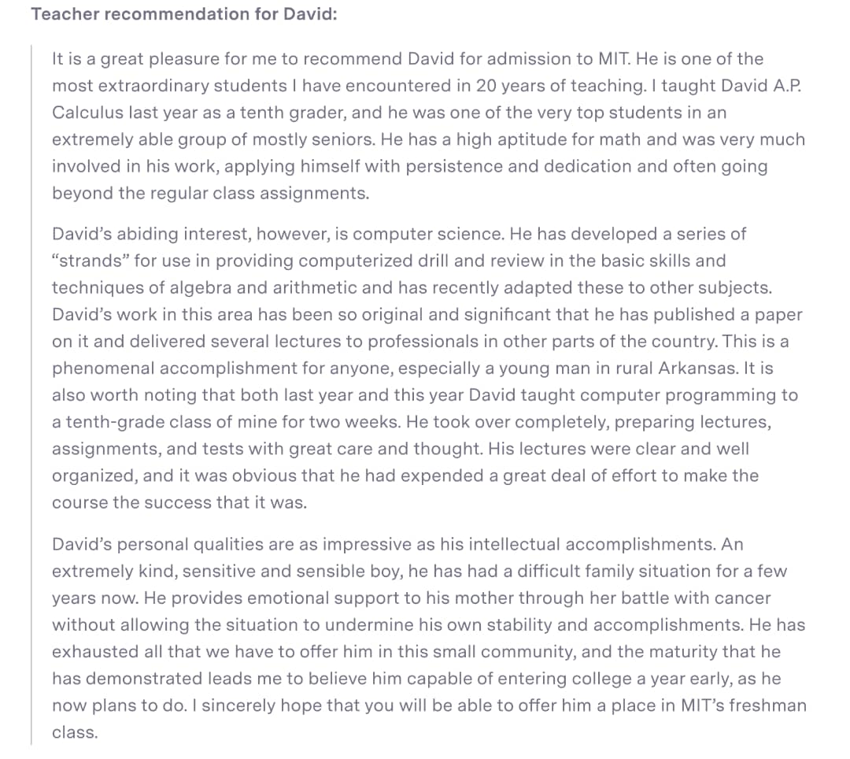
Sample of LoR

Slide 22
Other requirements/necessities
4. proposal (for PhD applications): Containing the background to the study, statement of the research problem, the aim and objectives, methodology and analytical framework and significance of the proposed study and references – in not more than 8 pages
5. transcripts from all post-secondary schools attended after high school.
6. A writing sample (in English), 15-20 pages long. The best writing sample is an academic paper you wrote for a class related to the area in which you apply. A portion of a longer thesis is also acceptable but with a cover page identifying it as a chapter or section of a longer work.
7. Language proficiency results (IELTS, TOEFL) or Letter of proficiency in English
8. GRE (for PhD applicants in the sciences and social sciences)
Cold emails to prospective supervisors
Preparations for an interview with prospective supervisor/admission committee

Slide 23
Thank you for your attention!

