Slide 1
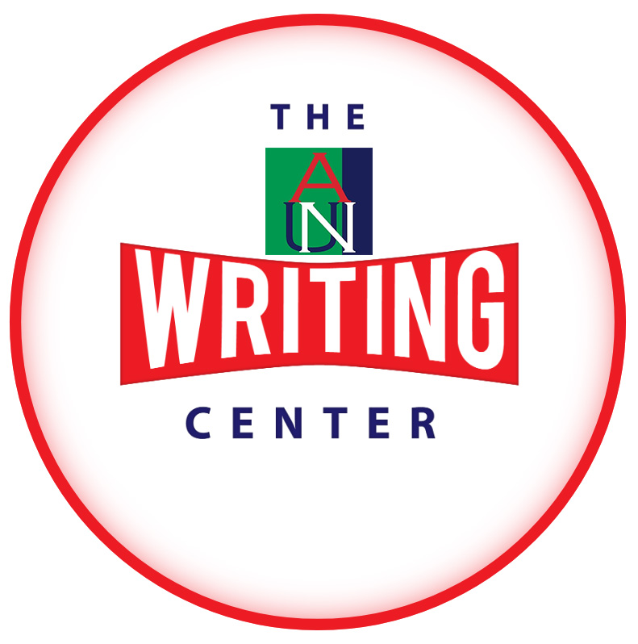
Punctuation: A Tool for Effective Writing
Seun Adeleke, PhD

Slide 2
PUNCTUATION MARKS
They are used to indicate the meaning of a grammatical structure.
They express the grammatical function of a particular structure.
Is the structure a question, statement, or exclamation?
There are approximately 14 punctuation marks in the English language.

Slide 3
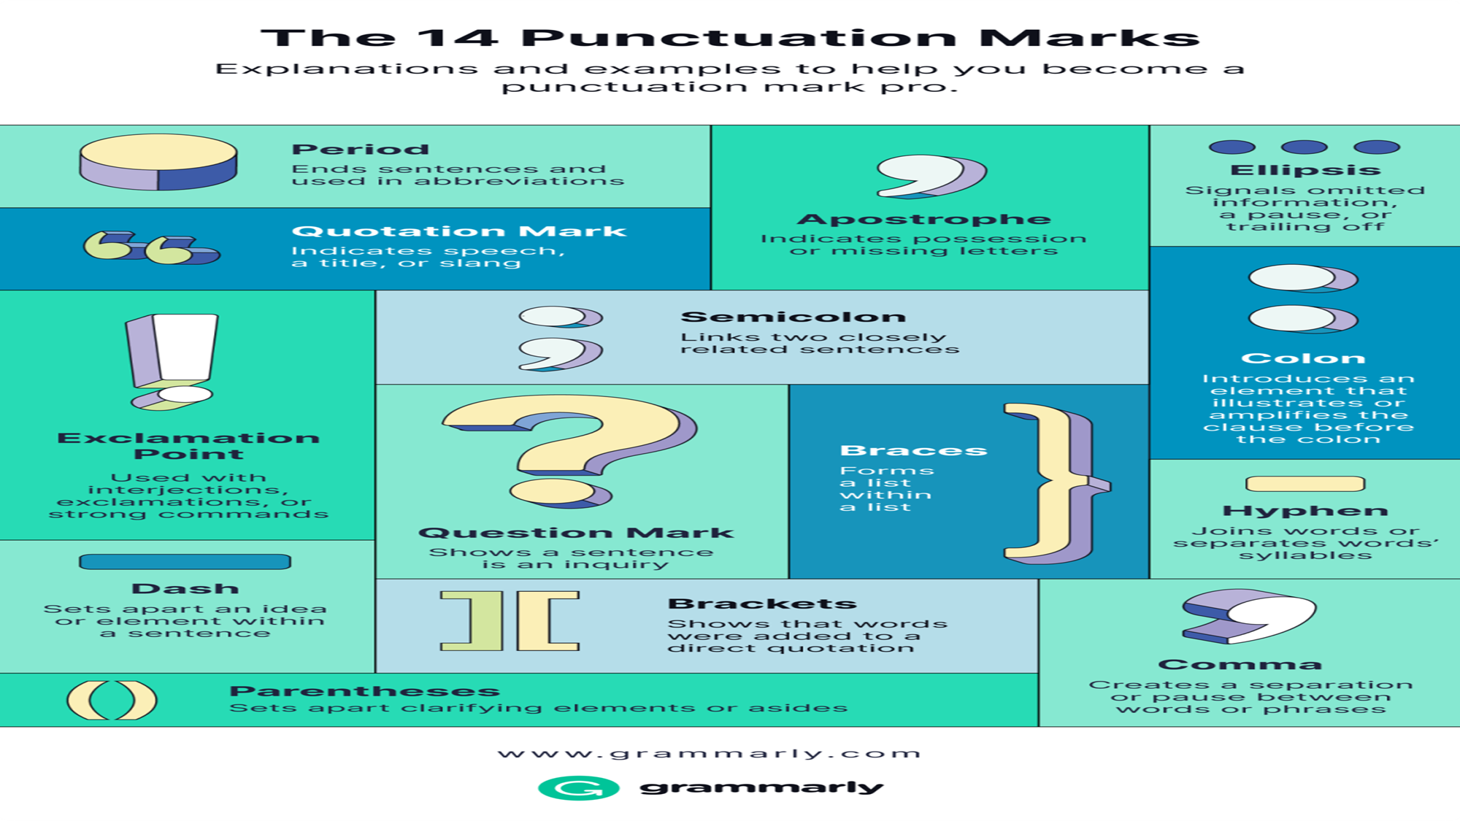
PUNCTUATION MARKS
They are used to indicate the meaning of a grammatical structure.
They express the grammatical function of a particular structure.
Is the structure a question, statement, or exclamation?
There are approximately 14 punctuation marks in the English language.

Slide 4
A COMMA (,)
A comma indicates a short pause in a sentence and can be used to clarify meaning.
The uses of commas are sometimes controversial, there is no agreed set of rules (Sandra Scary and John Scary 2005).

Slide 5
USES OF A COMMA (,)
To separate three or more items in a sequence He bought toys, fruits, and a golden pen.
When two simple sentences are joined with a coordinator (and, but, for, nor, or, so, yet), a comma is placed before the conjunction.
Examples
Many people showed interest, but few took the necessary steps.

Slide 6
USES OF A COMMA (,)
To separate adjectives that qualify a noun: This is my favorite, green coat.
Avoid a comma when the adjectives are often used together. Example: He took a long hot bath. (GSBE)
To set off dates (note the difference between British and American styles of writing dates), addresses, and geographical names: Today is Monday, March 18, 2024.
Monday, 18 March 2024 (British)
I studied English at the American University of Nigeria, Yola, Adamawa.

Slide 7
USES OF A COMMA (,)
After a dependent clause that starts a sentence:
Although she came late for the test, she passed excellently.
The position of a comma can change the meaning of a grammatical structure (Field 2009).
As mentioned, first impressions can be misleading.
As mentioned first, impressions can be misleading.
When addressing a person by name: Caine, where are you?
To separate direct speech: ‘I can’t,’ she replied.

Slide 8
USES OF A COMMA (,)
To set off parenthetical comments
His statement, I observed, was erratic.
Culture in African societies, I submit, should be pluralized.
After an introductory phrase (if the introductory phrase is short, the comma after it is optional):
          In this section, we discuss punctuation
          or
          In this section we discuss punctuation.

Slide 9
USES OF A COMMA (,)
To indicate contrasting phrases
The student, not the teacher, reviewed the article.

Slide 10
USES OF A SEMICOLON (;)
to separate two independent clauses that are not joined by a conjunction
The students wrote the test in a hurry; the teacher left after the test.
to separate items in a list that already contains commas
The color groups were red, yellow, and blue; orange, green, and purple; or black, gray, and brown. (APA)
to separate multiple parenthetical citations
Gaddis, 2018; Lai et al., 2016; Williams & Peng, 2019 (APA)

Slide 11
USES OF AN APOSTROPHE (‘)
To indicate possession: singular – Janet’s bag, Fatima’s purse, Audu’s pen, dog’s tail;
Plural – in irregular plurals, add ‘s: children’s toys, women’s bags
In regular pluralization, add the apostrophe after the ‘s’: ladies’ pen, brothers’ clothes
To indicate contraction: I’ll, she’ll, let’s, etc.
To form the possessive of nouns in a series, add a single apostrophe and an s if the ownership is shared Audu and Fatima’s car, etc.
But if the ownership is separate, place an apostrophe and an s after each noun. For example, Audu’s and Fatima’s cars, etc.

Slide 12
USES OF AN APOSTROPHE (‘)
Use an apostrophe to form the plurals of letters (MLA).
The word accommodation has two c’s and two m’s.
Use an apostrophe to form the plurals of letter grades.
She got three A’s this semester.

Slide 13
CAVEAT
Do not use an apostrophe to form the plural of an abbreviation or a number. Correct examples are PhDs, 1960s, fours, etc.
Beware of confusing possessive pronouns with contractions. The possessive pronouns do not include an apostrophe.
Incorrect: Your’s, their’s, etc.
Avoid confusing whose with who’s and its with it’s.
whose (a possessive pronoun) who’s (contraction of who is)

Slide 14
CHECK THIS
The sculptor _____ exhibiting his work just arrived at the gallery. (who’s, whose) -- Judith Nadell, et al.
The stick hit __ tail. (its, it’s)

Slide 15
USES OF A HYPHEN
A hyphen divides a word at the end of a line (should be according to syllables): ed-u-ca-tion
A hyphen connects compound words (use a dictionary as a guide): brother-in-law, empty-handed, far-fetched, etc.
A hyphen denotes the syllabification of words (in dictionaries).
A hyphen connects a phrase that modifies a noun. For example: the five-year-old girl
A hyphen is used to connect compound numbers, dates, or fractions. For example, twenty-five, 9-3-2024, two-thirds, etc.

Slide 16
DO NOT HYPHENATE
Do not hyphenate an adjective that includes an adverb ending in –ly (MLA)
a thoughtfully presented argument
Fractions used as nouns (APA): Two third of the students are here.
However, MLA recommends using a hyphen in simple fractions, no matter their part of speech. For example: He watched only one-third of the movie.
No hyphen is needed in a compound adjective that includes a comparative or superlative description formed with less, least, more, or most. For example, the less expensive option

Slide 17
DO NOT HYPHENATE
When you are writing for a specialized field, no hyphen is needed in a common compound adjective. For example, second language acquisition, Black American vernacular, etc.
A hyphen is not needed for a foreign-language adjective or phrase. For example, ad hoc, sine qua non, sui generis, etc.

Slide 18
ITALICS
Italics are slanted letters.
They are used to emphasize a word, phrase, or clause. For example: The uses of a comma remain controversial among scholars.
They indicate the title of a book. For example: Chinua Achebe’s Things Fall Apart is an African classic.
Italics indicate loan/foreign words. For examples: sui generis, étagère, etc.
To express biological terms, for example, Homo sapien, Cebus apella

Slide 19
DO NOT ITALICIZE THE FOLLOWING
Titles of book series (e.g., the Harry Potter series)
The punctuation mark after an italicized word or phrase
Who is the author of Things Fall Apart?
Note: Italicize a punctuation mark that is part of an italic element, such as a colon, comma, or question mark within a book title, periodical title, or heading (APA).

Slide 20
A COLON (:)
Use a colon after an independent clause when the material that follows is a series of items, an illustration, or an explanation. Example: I bought some items: magazines, novels, and periodicals.
Do not use a colon directly after a verb, after a preposition except or regarding, or after the expression such as, for example, especially, or including.
I ordered: belts, shoes, and bags. (Incorrect, remove the colon)

Slide 21
A COLON (:)
Use a colon when indicating time. Examples: 5:15 PM, 3:30 AM
Use a colon between the title and subtitle of a book. Mastering English: The Simple Logic

Slide 22
Dash (—)
According to Scarry and Scarry, “Use dashes for a less formal and more emphatic interruption of the main idea. Dashes are seldom used in formal writing.” (254). Example: She came—I am sure—very late.

Slide 23
EXERCISE
Correct the punctuation errors in this sentence.
To measure crime, sociologists have used three different techniques official statistics, victimization surveys, and self-report studies.
The most overused bodies of water are our rivers but they continue to serve us daily.
Some parts of our country I believe do not have ample supplies of water.

Slide 24
REFERENCES
Field, Marion. Improve your Punctuation and Grammar, 3rd edition. How to Books, 2009.
“Grammar and Style in British English: A Comprehensive Guide for Students, Writers and Academics.” https://www.gsbe.co.uk/grammar-commas-and-full-stops.html
MLA Handbook, ninth edition. The Modern Language Association of America, 2021.
Nadell, Judith and Langan, John. The Longman Reader, twelfth edition. Pearson Education, Inc., 2019
Publication Manual of the American Psychological Association, seventh edition. American Psychological Association, 2020.
Scarry, Sandra and Scarry, John. The Writer’s Workplace with Readings: Building College Writing Skills, seventh edition. Australia: Wadsworth Cengage Learning, 2010.

Slide 25

Questions?
Q & A

Slide 26


