Slide 1

Time Management:
An Essential College Skill
Friday, 13 September 2024
24HR Room
Presenter: Dr. Seun Adeleke

Slide 2
time management as an essential college skill
Time management is essential in balancing your life in a college such as AUN.
There are always assignments to submit, problems to solve, quizzes to answer, tasks to attend to, and meetings to attend.
In AUN, you must balance academics, personal life, and extracurricular activities.
The difficult part is that time is finite.

Slide 3
General question
What is time management?

Slide 4
The meaning of time management
Making the best use of time
Getting more done in the time available
Getting more control over time
Spending more time on important tasks

Slide 5


Who do you want to be?

Slide 6
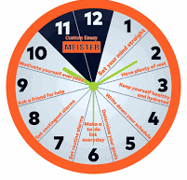
Time management
According to the Institute of Leadership and Management,
Managing time means taking more control over how you spend your time and making sensible decisions about the way you use it.
Managing time also requires distinguishing between short and long-term tasks.

Slide 7
To realize the value of time
Ask a student who failed a course.
Ask the person who just avoided a traffic accident.
To realize the value of one millisecond, ask the person who won an Olympic medal.

Slide 8
Some questions
Managing time means getting more _________ over how we spend our time and making sensible _________ about how we use it.
Managing time means making the _________ __________ of your time.

Slide 9
The significance of time management at aun
It helps you balance multiple responsibilities.
It aids stress management.
It helps in setting priorities.
It improves academic performance.
It enhances self-discipline.

Slide 10
activity
Make a list of items and activities that you confront on a daily or near-daily basis. Assign each a numerical value from 1 to 5, with 1 representing an item over which you have no control and 5 an item over which you have complete control

Slide 11
Time management techniques
Prioritization
The Pareto Principle
Setting Deadlines
Setting Boundaries

Slide 12
prioritization
Use the ABC or 123 system to order your priorities.
A/1 tasks are the most important.
B/2 tasks are to be done soon.
C/3 tasks can be put off without creating dire consequences, according to Marc Marcini
The beauty of the ABC system is that it helps strip away the emotions we have about each task.
You should differentiate between critical and urgent priorities.

Slide 13
activity
Use the ABC or 123 system to order these activities.
Visit your friend that was delivered of a baby.
Start an assignment with a deadline in a week.
Prepare for a quiz the next day.
Start an assignment that will be due in three days.
Organize an executive meeting for your association.
Go to the AUN Club to swim.

Slide 14
The pareto principle
It is similar to prioritization and known as the 80/20 principle.
The principle was introduced by Vilfredo Pareto, an Italian Economist, in 1906.
20% of our activities produce 80% results, while 80% activities generate 20% effects.
Focus on the 20% activities that produce 80% results.

Slide 15
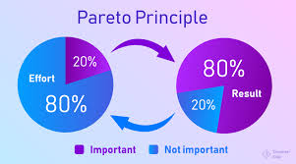
The pareto principle

Slide 16
Setting Deadlines
Deadlines make you focus.
They motivate you to prioritize your activities.
You should set deadlines for all tasks.
Follow the 80/20 principle.

Slide 17
Setting boundaries
Learn to say no to unnecessary meetings.
Avoid distractions.
Protect your time with care.

Slide 18
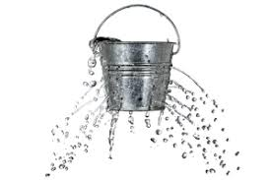
BE WARY OF Time leak
The time leak, according to Marcini Marc, are
The social media
Socializing
Misplacing things
Forgetting things
Long-winded people (talkers)

Slide 19
Other notes on time management
Create a calendar (Google Calendar, Calendly, etc.).
Set reminders.
Make time to have fun.
Find support.
Be realistic and flexible.
Source: https://summer.harvard.edu/blog/8-time-management-tips-for-students/

Slide 20
activity
Dramatization of dismissing long-winded people

Slide 21
References
Harvard Division of Continuous Learning. “8 Time Management Tips for Students.” 14 Oct. 2022, https://summer.harvard.edu/blog/8-time-management-tips-for-students/. Harvard Summer School.
Institute of Leadership and Management. Achieving Objectives Through Time Management. Pergamon Flexible Learning, 2007.
Marcini, Marc. Time Management. McGraw-Hill, 2003.

Slide 22

Questions?
Q & A

Slide 23
