Slide 1

(University) Writing skills
Caryn West RN, Cert CR & GCP, GDip Res Methods

Slide 2
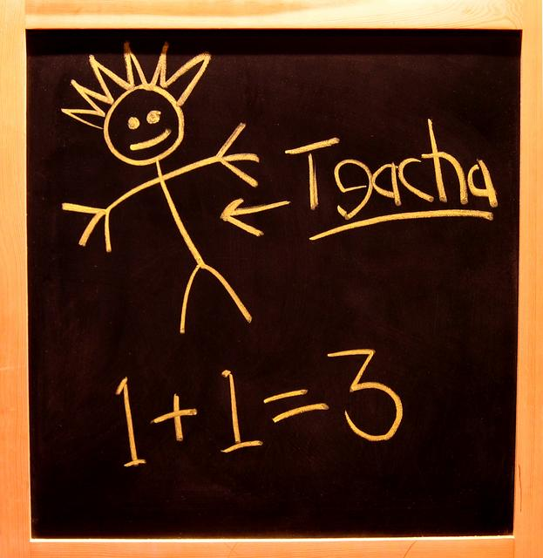
Whether you’re a student or a teacher, academic writing skills are necessary.
Essays, reports, presentations, and research papers are just some examples of documents written in the academic style.

Slide 3

Academic writing, when used appropriately, presents a polished and professional image.
Academic writing
skills include strong
composition, excellent
grammar, and a consistent
stylistic approach.

Slide 4
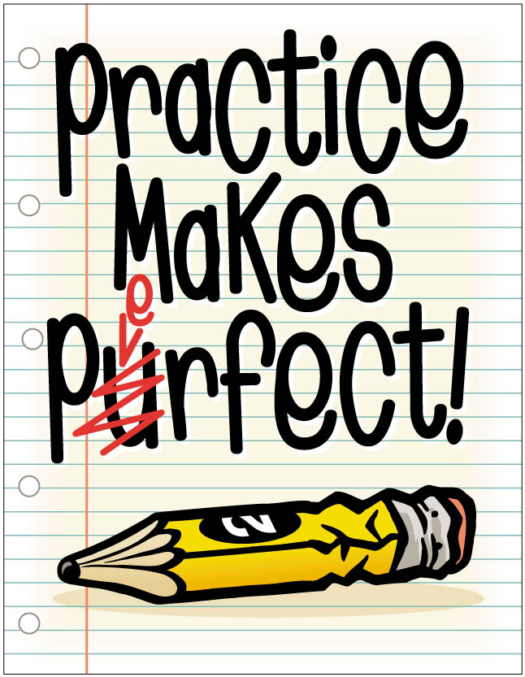
Academic writing is a learned skill and,

Slide 5
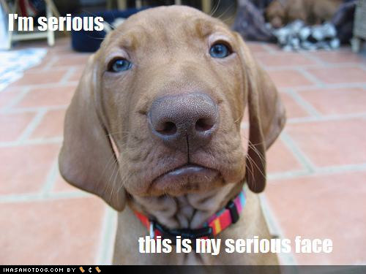
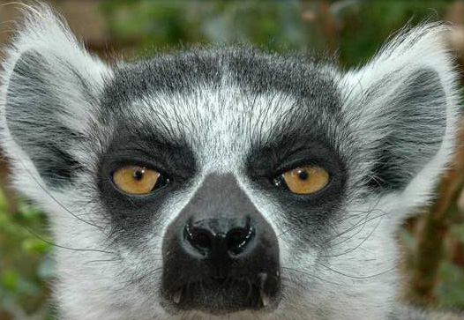
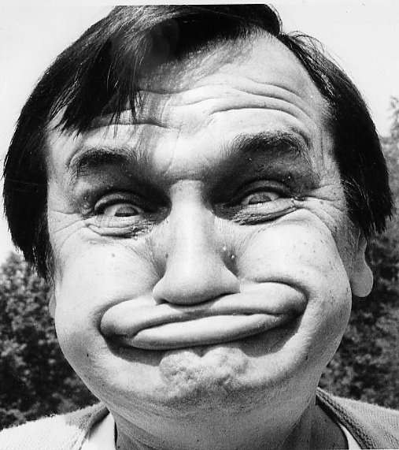
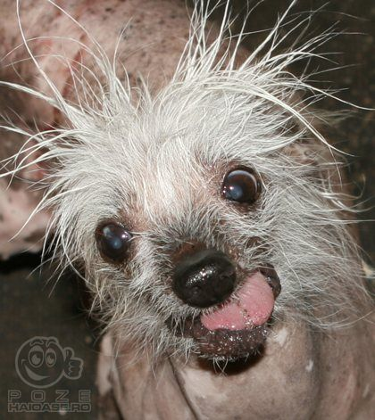

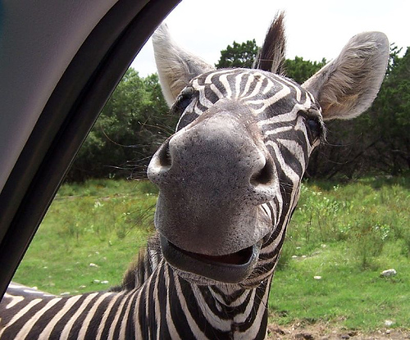
What is academic writing?
Academic writing refers to a particular style of expression.

Slide 6
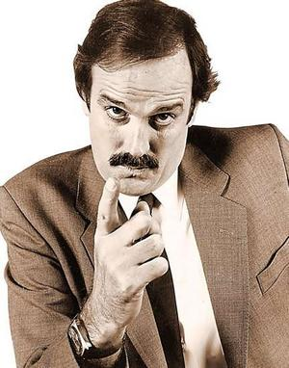
Characteristics include
-A formal tone,
-use of the third-person rather than first-person perspective,
-a clear focus on the issue or topic rather than the author’s opinion, and
-precise word choice.

Slide 7

Writers using the formal academic style avoid jargon, slang, and abbreviations/contractions.

Slide 8
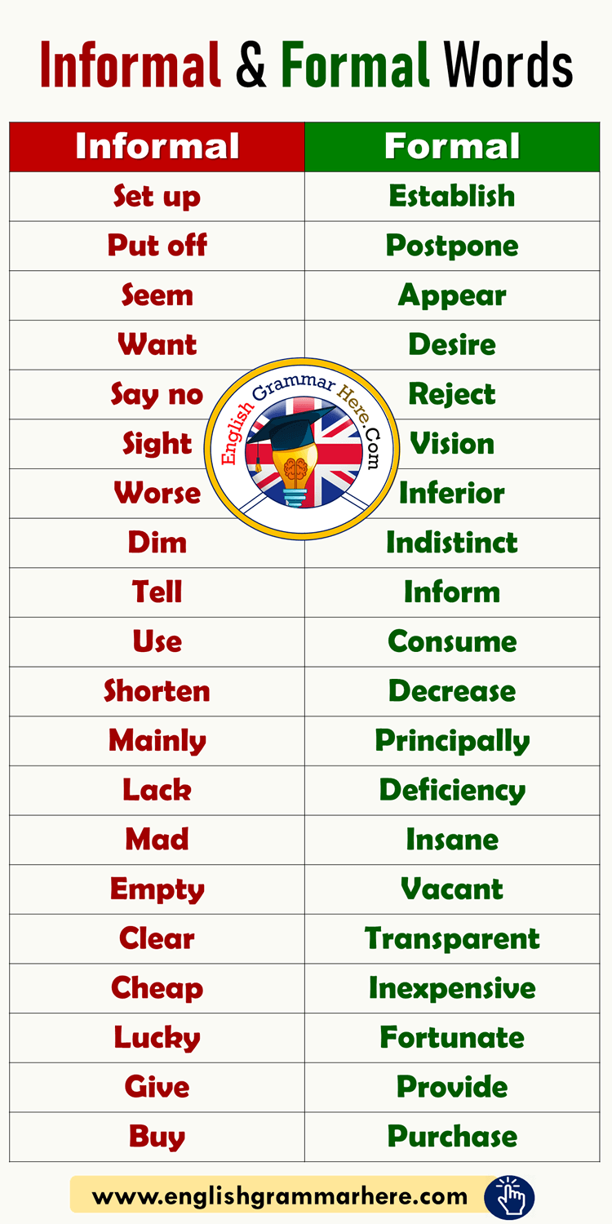
Academic writing is formal writing. Many beginner writers have trouble telling informal writing apart from formal writing and use informal writing since it’s easier and more familiar.

Slide 9
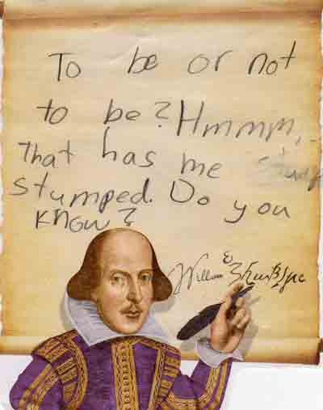
Characteristics of informal writing
- the use of colloquialisms and jargon,
writing in the first person or making “I” statements,
- making direct personal statements, and
-imprecise word choices.

Slide 10
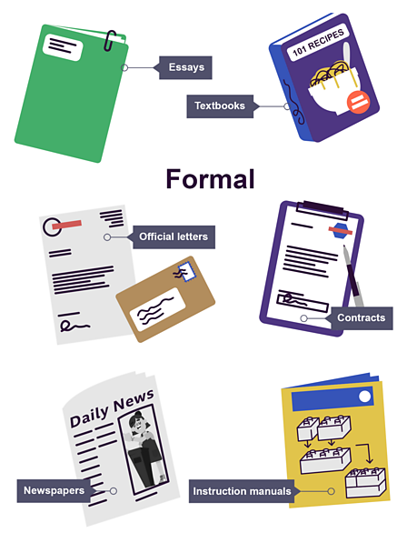
There’s a time and a place for informal writing.
Informal writing is fine for diary entries, blogs, personal writing, letters or emails to friends.

Slide 11
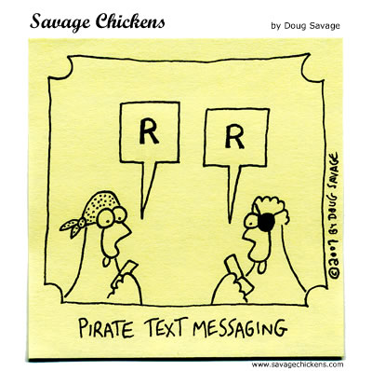
The most informal writing imaginable is the text message, full of abbreviations such as “R U here?” to convey quick questions and responses.
In comparison, the most formal writing of all can be found in legal documents.

Slide 12
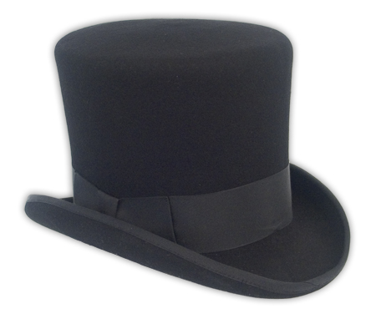

Writers working on papers for school, college application essays, scientific papers, research papers, conference presentations, and business proposals generally employ a more formal style like wearing a suit or dress to attend an official function.

Slide 13

Good Guides
Assignment writing
A Visual Guide to Essay Writing

Slide 14
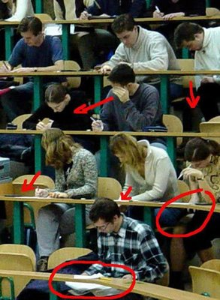
What is plagiarism
Copying of passages/text/work/
ideas without proper acknowledgement of the author. This includes other students work.

Slide 15
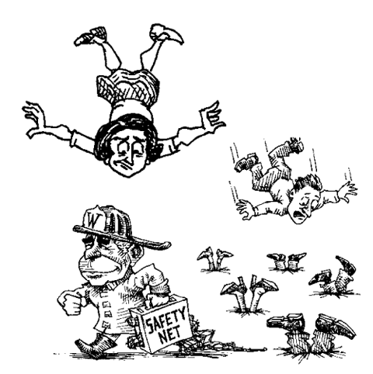
Safe assignment

Slide 16
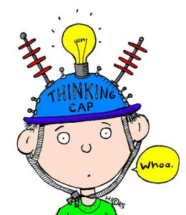
Getting started
Find your time
Find your space
Discipline, self & others
Brain storming, clustering, mind mapping
Free writing

Slide 17
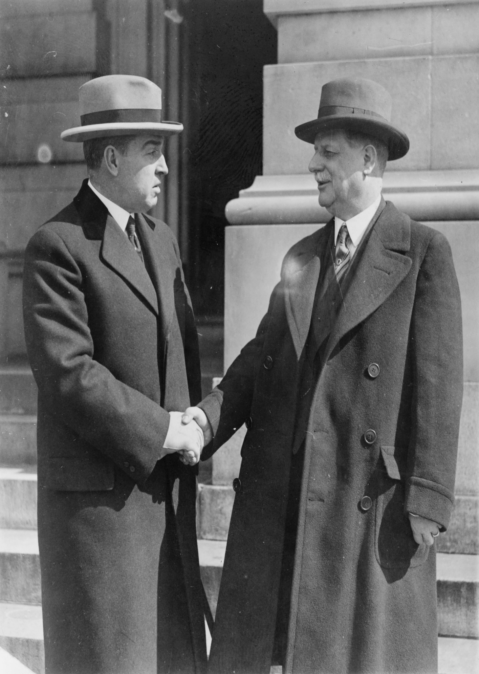
Introduction
What is the question?
Global view from the broad to the narrow
Introduce the :
    Who
    What
    When
    Where
    Why
    How

Slide 18

The topic
Why is it being asked?
Is it multi-layered?
Does it invite a largely factual response?
Is it looking for a particular stance such as an argument or a critique?

Slide 19
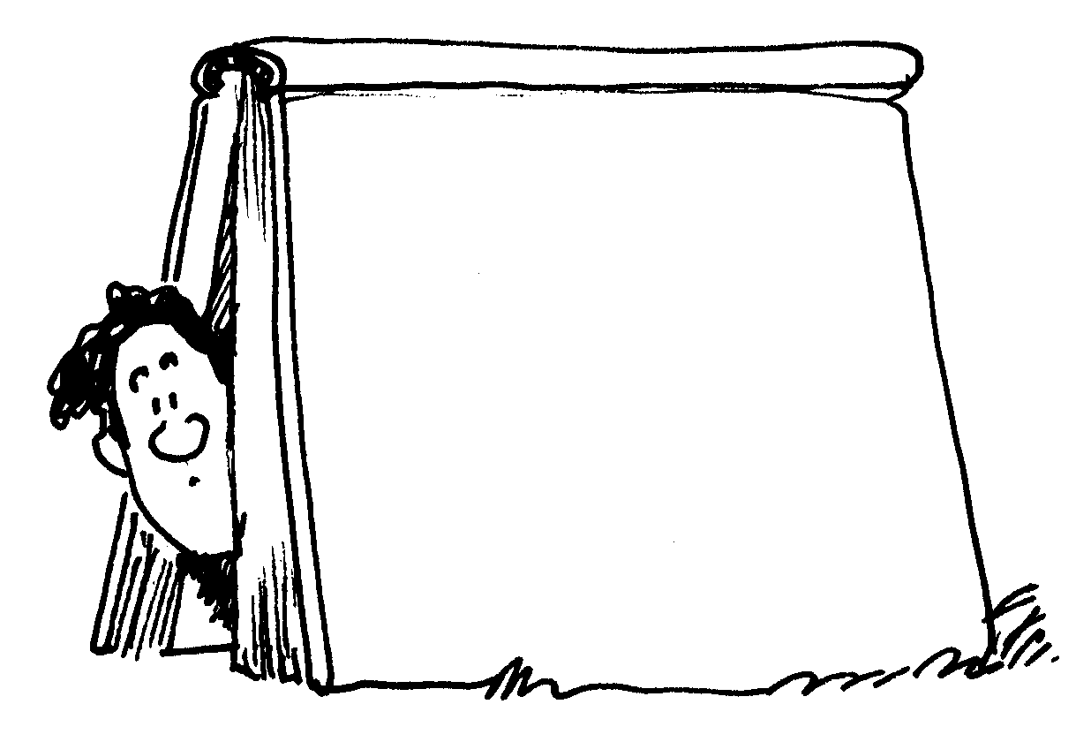
Literature
Is it current?
Is the author a credible source?
Is the subject relevant?

Slide 20
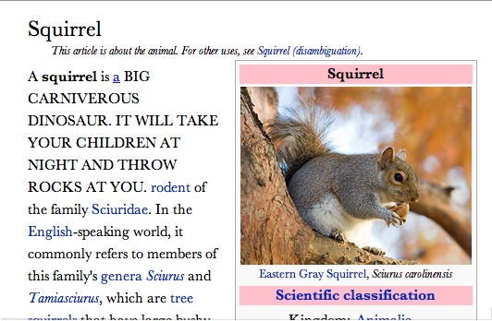
Wikipedia
IS NOT A CREDIBLE SOUCE

Slide 21

Beginning
A quotation – is it relevant
A question
An opinion
An interesting fact
An irony or paradox
An analogy
And anecdote

Slide 22

Body
Your paragraphs should flow naturally into one another, and connections should be made

Slide 23
Paragraphs
7-8 sentences
Each should be topic specific, preferably with an introductory sentence
Each sentence state the content/context and then some supporting example which is where the references come in.
The last sentence concludes the paragraph and moves to the next.

Slide 24
Transitional words
Joining words
        Also, and, again, etc
Comparing words
        Also, in comparison
Contracting words
        Although, but, conversely, despite, even though, however
Positioning words
        Above, adjacent to, below
Situation words
        Before, briefly, consequently, finally, first

Slide 25
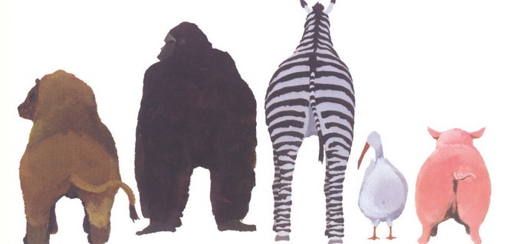
Conclusions
Don’t introduce anything new
Draw in the introduction
Demonstrate a conclusion or a lack of conclusion
Give the essay a sense of completeness
Leave a final impression

Slide 26

Revision
Links and gaps
Be ruthless
Read text out loud
Content revision – does it answer the question?
Grammatical and presentation revision
Spelling!!!

Slide 27

Edit
Another pair of eyes
Bottom line…. You have to communicate with the marker you do not get to sit next to them.

Slide 28
Final Tips for Effective Writing
Put the reader first
Use simple words and short sentences
Use jargon only when necessary
Write with verbs and nouns
Format to improve readability

